Slide 1

WSQ Course Code: TGS-2024043854
Build a Human–AI Workforce
with Autonomous AI Agents
Version 2.0 · 18 October 2026
Tertiary Infotech Academy Pte Ltd
UEN: 201200696W
www.tertiarycourses.com.sg | enquiry@tertiaryinfotech.com | +65 6100 0613
© Tertiary Infotech Academy Pte Ltd. All rights reserved.

Slide 2

HOUSEKEEPING
Digital Attendance
Attendance is mandatory for SSG funding.
Minimum
75%
Take AM, PM and Assessment digital attendance for every session.
Scan the SSG digital attendance QR code shown by your trainer with your phone camera.
The TRAQOM survey and Assessment attendance are taken on assessment day.
attendance required
© Tertiary Infotech Academy Pte Ltd
Human-AI Workforce with Autonomous AI Agents · TGS-2024043854
2

Slide 3




INTRODUCTION
About the Trainer
Qualifications: ________________________________________________
?
Expertise: ________________________________________________
[ Trainer Name ]
[ Title / Role ]
Experience: ________________________________________________
Contact / Profile: ________________________________________________
© Tertiary Infotech Academy Pte Ltd
Human-AI Workforce with Autonomous AI Agents · TGS-2024043854
3

Slide 4




INTRODUCTION
About the Trainer
Qualifications PhD-qualified trainer specialising in AI, automation and software engineering.
AA
Expertise Builds autonomous AI agents and multi-agent workflows with Hermes Agent, Paperclip and Claude Code.
Dr. Alfred Ang
Experience Trains professionals across Singapore on practical, project-based AI skills.
AI Trainer & Engineer
Tertiary Infotech Academy
Certifications PMP, AWS, Microsoft, CompTIA, CKA, CKAD.
Profile linkedin.com/in/angchewhoe · github.com/alfredang
© Tertiary Infotech Academy Pte Ltd
Human-AI Workforce with Autonomous AI Agents · TGS-2024043854
4

Slide 5


INTRODUCTION
Let's Know Each Other
Take a minute to introduce yourself to the class:
Your name & role
What you do day to day
Your experience with AI or agents
One task you want an AI agent to take off your plate
© Tertiary Infotech Academy Pte Ltd
Human-AI Workforce with Autonomous AI Agents · TGS-2024043854
5

Slide 6





HOUSEKEEPING
Ground Rules
Phones on silent
Participate actively
Mutual respect
Step out quietly for calls or breaks.
No question is too small — ask freely.
Agree to disagree; one conversation at a time.
Be punctual
75% attendance
Stay hands-on
Return from breaks on time.
Required for funding eligibility.
Follow along with every lab.
© Tertiary Infotech Academy Pte Ltd
Human-AI Workforce with Autonomous AI Agents · TGS-2024043854
6

Slide 7
ROADMAP
Course Outline
Three topics, ten connected use-case labs, one company: Kopi Kaki Co..
1
2
3
Foundations of Autonomous AI Agents & the Human–AI Workforce
Hermes Agent — From a Single AI Employee to a Multi-Agent Team
Paperclip — Running & Governing a Company of AI Agents
• A brief history of AI
• AI agents vs agentic AI
• The agentic loop & harness engineering
• Brain · perception · action, memory & world models
• From single agent to human–AI collaboration
• The 2026 agent market, use cases & governance
• Lab 1 · Your first AI employee
• Lab 2 · End-to-end social media campaign
• Lab 3 · Human-in-the-loop publishing
• Lab 4 · Multi-agent video studio
• Lab 5 · Campaign command centre
• Lab 6 · Found the AI company
• Lab 7 · Hire the team
• Lab 8 · Launch campaign project
• Lab 9 · Weekly video routine
• Lab 10 · Govern, measure & improve
© Tertiary Infotech Academy Pte Ltd
Human-AI Workforce with Autonomous AI Agents · TGS-2024043854
7

Slide 8



WHAT YOU'LL ACHIEVE
Learning Outcomes
Mapped to the TSC Artificial Intelligence Application in Product Development (ICT-TEM-4034-1.1).
LO1 · Analyse AI applications
LO2 · Agent design and efficiency
LO3 · Evaluate & improve
Analyse AI (LLM-based) applications across a range of industries to identify their capabilities and limitations.
Evaluate and improve the effectiveness of AI (RAG and agent) applications in product development.
Establish the relationship between AI algorithm/agent design and chatbot/agent efficiency.
© Tertiary Infotech Academy Pte Ltd
Human-AI Workforce with Autonomous AI Agents · TGS-2024043854
8

Slide 9
WHAT YOU'LL ACHIEVE
Learning Units, Topics and Labs
Approved Course Proposal: TSC ICT-TEM-4034-1.1 Artificial Intelligence Application in Product Development — 16 hours.
LU | Learning unit | Delivered through | K & A | Hours
LU1 | Foundations of autonomous AI agents and single-agent LLM applications | Topic 1 (Foundations) + Topic 2 Labs 1–2 (single Hermes agent) | K1, K6, A1, A3 | 5 h
LU2 | Agent and multi-agent design for efficiency, with humans in the loop | Topic 2 Labs 3–5 (human-in-the-loop, multi-agent studio, swarm) + Topic 3 Lab 6 (designing a governed agent company) | K4, K5, A2, A6 | 5 h
LU3 | Evaluate and improve the effectiveness of an AI-agent workforce in product development | Topic 3 Labs 7–10 (team, launch project, routine, governance and improvement) | K2, K3, A4, A5 | 4 h
Assess | WA-SAQ (1 h) + Practical Performance (1 h) | Day 2, 4:30–6:30 PM | K1–K6 · A1–A6 | 2 h
© Tertiary Infotech Academy Pte Ltd
Human-AI Workforce with Autonomous AI Agents · TGS-2024043854
9

Slide 10
ROADMAP
Lesson Plan — Day 1 (9:30 AM – 6:30 PM)
Time | Session | LU
9:30–9:50 | Welcome, housekeeping, trainer introduction, learning outcomes and AM digital attendance | LU1
9:50–11:05 | Topic 1 (Part A) — history of AI; AI agents vs agentic AI; the agentic loop; harness engineering; brain–perception–action; short- and long-term memory; RAG; world models | LU1
11:05–11:20 | Tea break | LU1
11:20–12:10 | Topic 1 (Part B) — single agent → multi-agent → human–agent collaboration; levels of autonomy; agent society; the 2026 agent market (OpenClaw, Hermes, Paperclip, OpenAI Dots, Meta Muse, Block Buzz, Manus Cue …); Singapore's AgentSea; human–AI use cases in science, maths, drug discovery and business; risks and governance | LU1
12:10–12:35 | Activity — Human–AI Workforce Canvas for Kopi Kaki Co., and start the Hermes Agent install | LU1
12:35–13:30 | Topic 2 — Lab 1: Hire Your First AI Employee (Hermes) — customer & market research brief | LU1
13:30–14:30 | Lunch break | —
14:30–15:30 | Lab 2: End-to-End Social Media Campaign with one agent (skills + tools) | LU1
15:30–16:15 | Lab 3: Human-in-the-Loop Publishing & Community Care (Telegram + cron) | LU2
16:15–16:30 | Tea break | LU2
16:30–17:30 | Lab 4: Multi-Agent Video Studio — research → script → production → audit → publish | LU2
17:30–18:15 | Lab 5: Multi-Agent Campaign Command Centre — measure, optimise & report | LU2
18:15–18:30 | Day 1 recap, Q&A and PM digital attendance | LU2
© Tertiary Infotech Academy Pte Ltd
Human-AI Workforce with Autonomous AI Agents · TGS-2024043854
10

Slide 11
ROADMAP
Lesson Plan — Day 2 (9:30 AM – 6:30 PM)
Time | Session | LU
9:30–9:45 | Day 1 recap and AM digital attendance | LU2
9:45–10:15 | Topic 3 — Paperclip: the company as the agent harness; Board, CEO and org chart; adapters; goals, projects and tasks; routines and heartbeats; budgets, approvals and the audit trail | LU2
10:15–11:15 | Lab 6: Found Kopi Kaki Growth Studio — an AI company you govern | LU2
11:15–11:30 | Tea break | LU2
11:30–12:15 | Lab 7: Hire the Marketing Team through the Board approval gate | LU3
12:15–13:15 | Lunch break | —
13:15–14:10 | Lab 8: Run the #ShiokColdBrew launch as a project — review, revise, release | LU3
14:10–14:55 | Lab 9: Automate the weekly video pipeline with a routine and a Board gate | LU3
14:55–15:10 | Tea break | LU3
15:10–15:55 | Lab 10: Govern, measure & improve your human–AI workforce | LU3
15:55–16:15 | Course recap, practice exam and Q&A | LU3
16:15–16:30 | Briefing for Assessment | LU3
16:30–17:30 | Written Assessment (WA) — Short-Answer Questions (SAQ), 1 hour, open book | Assess
17:30–18:30 | Practical Performance (PP) — 1 hour, open book; TRAQOM survey and PM / assessment digital attendance | Assess
© Tertiary Infotech Academy Pte Ltd
Human-AI Workforce with Autonomous AI Agents · TGS-2024043854
11

Slide 12






ROADMAP · HANDS-ON
Ten Labs, One Company
Every lab builds on the last — the same Kopi Kaki campaign grows from one agent to a governed AI company.
LAB 1 · DAY 1
LAB 2 · DAY 1
LAB 3 · DAY 1
LAB 4 · DAY 1
LAB 5 · DAY 1
First AI Employee
Social Media Campaign
Human-in-the-Loop
Multi-Agent Video Studio
Campaign Command Centre
Single agent
Single agent + skills
Human–agent collaboration
Multi-agent (ordered pipeline)
Multi-agent (parallel swarm)
LAB 6 · DAY 2
LAB 7 · DAY 2
LAB 8 · DAY 2
LAB 9 · DAY 2
LAB 10 · DAY 2
Found the AI Company
Hire the Team
Launch Campaign Project
Weekly Video Routine
Govern & Improve
Human-governed company of agents
Multi-agent organisation
Multi-agent project with Board review
Scheduled multi-agent workflow
Workforce governance
TIP Day 1 = Hermes Agent (single → multi-agent). Day 2 = Paperclip (a governed company of agents).
© Tertiary Infotech Academy Pte Ltd
Human-AI Workforce with Autonomous AI Agents · TGS-2024043854
12

Slide 13
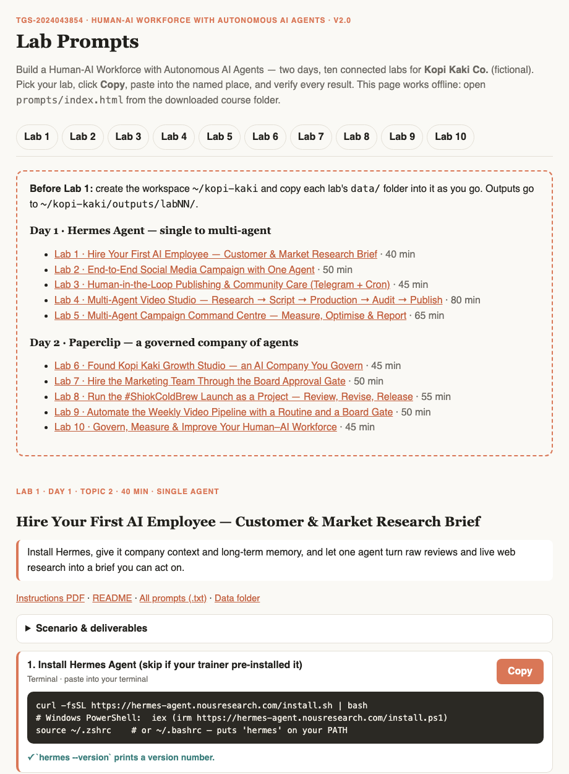



ROADMAP · HANDS-ON
Lab Materials & the Lab Prompts Page
Everything you need is in the course repo: instructions PDF, mock data, skills and copy-ready prompts for every lab.
Get the labs
github.com/tertiarycourses/TGS-2024043854-… → Code → Download ZIP. Unzip anywhere.
Open the prompts page
Double-click prompts/index.html — pick your lab, click Copy, paste into Hermes, Telegram or Paperclip.
Use the lab folder
labs/labNN-…/ holds README, LAB-NN-Instructions.pdf, COPY-PROMPTS.txt and data/.
Verify every result
Each lab ends with a checkpoint — evidence, not vibes.
© Tertiary Infotech Academy Pte Ltd
Human-AI Workforce with Autonomous AI Agents · TGS-2024043854
13

Slide 14



THE COURSE SCENARIO
Meet Kopi Kaki Co.
A fictional Singapore kopi chain — the company every lab works for. All data is synthetic.
12 outlets · 140 staff
Launch: Gula Melaka Cold Brew
Heritage kopi, modern craft — Tiong Bahru to Changi T3.
SGD 6.80 · 1 Dec 2026 · code SHIOK20 (20% off first app order, 1–14 Dec).
Campaign #ShiokColdBrew
Rules that matter
17 Nov – 14 Dec · SGD 15,000 · 2,500 pre-orders · 8% engagement · 40k views.
No health or halal claims · no competitor bashing · human APPROVE before anything is public.
© Tertiary Infotech Academy Pte Ltd
Human-AI Workforce with Autonomous AI Agents · TGS-2024043854
14

Slide 15
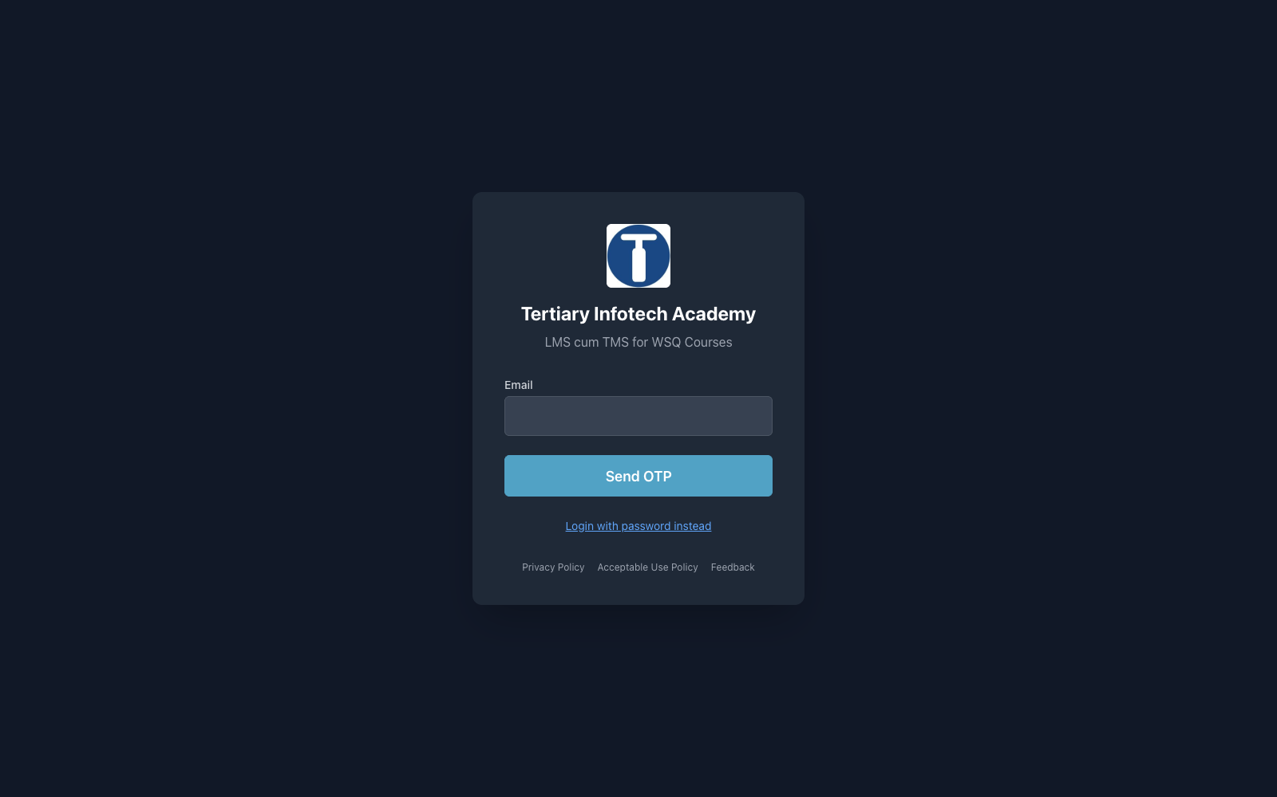


LEARNING MANAGEMENT SYSTEM
Courseware & Assessment on the LMS
Log in
lms-tms.tertiaryinfotech.com with your registered email + OTP.
Download the courseware
Slides, Learner Guide and Lesson Plan for the open-book assessment.
Take the assessment
Complete the WA and PP and upload your answers on the LMS.
▸ LMS: https://lms-tms.tertiaryinfotech.com/ → open this course → Courseware tab.
© Tertiary Infotech Academy Pte Ltd
Human-AI Workforce with Autonomous AI Agents · TGS-2024043854
15

Slide 16


LEARNING MANAGEMENT SYSTEM
Download Course Material
STEP 1
STEP 2
STEP 3
STEP 4
STEP 5
Open the LMS
Send OTP
Verify
Open the course
Download
Go to lms-tms.tertiaryinfotech.com
Enter your registered email and click Send OTP.
Key in the one-time password from your inbox.
Select Build a Human-AI Workforce with Autonomous AI Agents.
Slides PDF + Learner Guide — keep them for the open-book assessment.
© Tertiary Infotech Academy Pte Ltd
Human-AI Workforce with Autonomous AI Agents · TGS-2024043854
16

Slide 17




ASSESSMENT
Briefing for Assessment
Clear your space
No recording
Open book
Phones and other materials under the table or on the floor.
No photos or recording of assessment scripts.
Slides, Learner Guide and approved materials only.
Work individually
Manage your time
Appeals
No discussion during the assessment.
WA (1 hour) then PP (1 hour).
An appeal process is available if you disagree with the outcome.
© Tertiary Infotech Academy Pte Ltd
Human-AI Workforce with Autonomous AI Agents · TGS-2024043854
17

Slide 18

ASSESSMENT
Assessment & Funding
Final Assessment
Criteria for Funding
• Written Assessment (WA) — Short-Answer Questions (SAQ), 1 hour, open book.
• Practical Performance (PP) — three tasks, each with ONE screenshot from a lab (Lab 1 Hermes agent, Lab 4 multi-agent studio, Lab 7 Paperclip org chart) plus written analysis, 1 hour, open book.
• Day 2, from 4:30 PM — open book
• Allowed: slides, Learner Guide, approved materials
• Appeal process available
Minimum 75% attendance
Based on SSG digital attendance records.
Assessed as 'Competent'
Complete and pass both assessment components (WA and PP).
© Tertiary Infotech Academy Pte Ltd
Human-AI Workforce with Autonomous AI Agents · TGS-2024043854
18

Slide 19


ASSESSMENT
Assessment Flow
On assessment day, follow these five steps in order.
STEP 1
STEP 2
STEP 3
STEP 4
STEP 5
TRAQOM
Attendance
Assessment
Submit
Sign the record
Scan the TRAQOM QR code on the LMS and complete the survey.
Take the Assessment digital attendance (SSG QR).
Sit the WA (SAQ), then the PP — open book.
Upload your answers on the LMS.
Sign the Assessment Summary Record.
© Tertiary Infotech Academy Pte Ltd
Human-AI Workforce with Autonomous AI Agents · TGS-2024043854
19

Slide 20
TOPIC 1
1
A brief history of AI
Foundations of Autonomous AI Agents & the Human–AI Workforce
2
AI agents vs agentic AI
3
The agentic loop & harness engineering
4
Brain · perception · action, memory & world models
5
From single agent to human–AI collaboration
6
The 2026 agent market, use cases & governance
© Tertiary Infotech Academy Pte Ltd · TGS-2024043854

Slide 21
TOPIC 1 · HISTORY OF AI
A Brief History of AI — From Rules to Learning
Turing test
AI is named
Expert systems
Deep Blue
Deep learning
AlphaGo
Transformer
1950
1956
1970s
1997
2012
2016
2017
Turing asks "Can machines think?" and proposes the imitation game.
Dartmouth workshop coins "artificial intelligence".
Hand-written rules (MYCIN, XCON) — brittle, costly to update.
IBM beats Kasparov at chess with brute-force search.
AlexNet wins ImageNet — GPUs + big data.
Deep + reinforcement learning beats Lee Sedol 4–1.
"Attention Is All You Need" — the architecture behind every LLM.
Rules → Search → Learning → Language: each era moved more of the 'how' from humans into the machine.
© Tertiary Infotech Academy Pte Ltd
Human-AI Workforce with Autonomous AI Agents · TGS-2024043854
21

Slide 22
TOPIC 1 · HISTORY OF AI
A Brief History of AI, 2022–2026 — From Chat to Agents
ChatGPT
Prompt Engineering
Tools & MCP
Context Engineering
Harness Engineering
AI Agents
2022
2023
2024
2025
2026
2026
Launches 30 Nov 2022 — LLMs go mainstream. ReAct shows LLMs can reason and act.
GPT-4 (Mar 2023); results depend on how you word the prompt.
Model Context Protocol (Nov 2024) standardises how agents reach tools and data.
Claude Code & Codex coding agents; results depend on the context you curate.
The environment around the model is engineered: loop, tools, memory, checks, guardrails.
Always-on agents work 24/7 — OpenClaw, Hermes Agent, Paperclip, Dots, Muse.
From wording one prompt → curating context → engineering the harness → agents that work around the clock.
© Tertiary Infotech Academy Pte Ltd
Human-AI Workforce with Autonomous AI Agents · TGS-2024043854
22

Slide 23

TOPIC 1 · HISTORY OF AI
Prompt, Context & Harness Engineering
Each layer contains the one before it.
Prompt engineering
Context engineering
Harness engineering
Craft the instruction. One request, one answer. Quality depends on wording.
Example: "Write a caption for our new drink."
Curate what the model sees: brand guide, brief, data, memory, tool results — and nothing that wastes the window.
Example: AGENTS.md + campaign-brief.md loaded every session.
Design the whole environment: the loop, tools, memory, skills, verification, guardrails and human gates — so the agent does reliable long-running work.
Example: Lab 4's five-agent studio with an auditor and an approval gate.
© Tertiary Infotech Academy Pte Ltd
Human-AI Workforce with Autonomous AI Agents · TGS-2024043854
23

Slide 24

TOPIC 1 · HISTORY OF AI
The Range of AI Applications Today
Every industry uses several of these together — agents increasingly orchestrate the others.
Generative AI / LLMs
Computer vision
Predictive analytics & ML
Chatbots, writing, coding and summarising. Capability: understand and generate natural language, code and images.
Defect detection, medical imaging, product search. Capability: recognise and classify what is in images and video.
Demand forecasting, fraud scoring, recommendations. Capability: learn patterns in data to predict outcomes.
Speech & multimodal
Scientific discovery
Autonomous AI agents
Voice assistants, transcription, text-to-speech. Capability: convert between speech, text and other media.
AlphaFold, AI co-scientist, AlphaEvolve. Capability: generate and rank hypotheses and designs for experts to test.
Hermes, Paperclip, OpenAI Dots, AgentSea. Capability: pursue a goal with tools, memory and planning — with humans in the loop.
© Tertiary Infotech Academy Pte Ltd
Human-AI Workforce with Autonomous AI Agents · TGS-2024043854
24

Slide 25


TOPIC 1 · AI AGENTS VS AGENTIC AI
What Is an AI Agent?
"Autonomous software entities engineered for goal-directed task execution within bounded digital environments" — Sapkota et al., 2025
Goal-directed
Uses tools
Loops until done
Given a goal, it decides the steps itself instead of waiting for each instruction.
Searches the web, reads files, writes documents, calls APIs and MCP servers.
Acts, observes the result, checks it, and tries again.
Remembers
Bounded
Accountable human
Keeps context in the session and long-term memory across sessions.
Works inside permissions, budgets and approval gates set by humans.
A person owns the outcome — the agent recommends or acts on their behalf.
© Tertiary Infotech Academy Pte Ltd
Human-AI Workforce with Autonomous AI Agents · TGS-2024043854
25

Slide 26
TOPIC 1 · AI AGENTS VS AGENTIC AI
AI Agents vs Agentic AI
Source: Sapkota, Roumeliotis & Karkee, "AI Agents vs. Agentic AI", Information Fusion 2025 (arXiv 2505.10468).
Dimension | AI Agent | Agentic AI
Scope | One specific, well-defined task | A complex, multi-step goal or workflow
Architecture | One LLM + tools: perceive → reason → act | Several specialised agents + an orchestrator
Flow | User → Agent → Tool | User → System → Agent 1 → Agent 2 → …
Memory | Session context, optional cache | Shared, persistent memory across stages
Planning | Single-step, reactive | Multi-step, proactive goal decomposition
Coordination | Works alone | Hierarchical or decentralised hand-offs
Examples | Support bot, email triage, research agent (Lab 1) | Video studio (Lab 4), AI company (Labs 6–10)
Main risks | Hallucination, brittle prompts | Error propagation, misalignment, governance
© Tertiary Infotech Academy Pte Ltd
Human-AI Workforce with Autonomous AI Agents · TGS-2024043854
26

Slide 27

TOPIC 1 · AI AGENTS VS AGENTIC AI
An Analogy: the Smart Home
AI Agent — a smart thermostat
Agentic AI — the coordinated home
• Holds the room at 21°C
• One goal, one device, clear rules
• Reacts to the temperature it senses
• Kopi Kaki: Mia writes a research brief (Lab 1)
• Weather, energy-price, schedule, appliance and security agents work together
• Pre-cools with solar before a heatwave hits at peak price
• Plans ahead, hands off, adapts the goal
• Kopi Kaki: a 5-agent studio ships a video (Lab 4)
TIP Same LLMs underneath — the difference is orchestration, memory and coordination.
© Tertiary Infotech Academy Pte Ltd
Human-AI Workforce with Autonomous AI Agents · TGS-2024043854
27

Slide 28

TOPIC 1 · THE AGENTIC LOOP
The Agentic Loop
Every agent task runs the same repeating cycle. ReAct (2022) calls it Thought → Action → Observation.
1. Gather context
2. Take action
3. Verify work
4. Repeat
Read files and memory, search the web, call tools to understand the task.
Write files, run commands, call MCP tools and APIs to make progress.
Check the result — tests, a checklist, a screenshot, a second agent.
Feed results back as new context and loop until the goal is met.
Goal in → context → action → verification → repeat → goal met
© Tertiary Infotech Academy Pte Ltd
Human-AI Workforce with Autonomous AI Agents · TGS-2024043854
28

Slide 29

TOPIC 1 · THE AGENTIC LOOP
The Loop in Action — Mia's Research Brief (Lab 1)
Goal
"Write a research brief with three evidence-backed campaign angles."
Gather context
Loads AGENTS.md and memory, reads 60 reviews, searches 2026 cold-brew trends.
Reason & plan
Groups reviews into themes, compares competitors, drafts three angles.
Act
Writes review-insights.md and research-brief.md with citations.
Verify
Checks each claim has a review ID or URL; flags anything unverified.
Human checkpoint
You challenge a claim and choose the angle — Mia saves it to long-term memory.
© Tertiary Infotech Academy Pte Ltd
Human-AI Workforce with Autonomous AI Agents · TGS-2024043854
29

Slide 30

TOPIC 1 · THE AGENTIC LOOP
Why the Loop Matters
Give direction, not micro-steps
State the goal, constraints and definition of done; let the loop find the steps.
Verification is everything
An agent is only as good as its ability to check its own work — checklists, auditors, tests.
Steer mid-loop
Review plans and drafts early; send work back with specific feedback rather than waiting for a wrong final answer.
Context is the fuel
What the agent can see decides what it can do — that is why we give it AGENTS.md, skills and memory.
© Tertiary Infotech Academy Pte Ltd
Human-AI Workforce with Autonomous AI Agents · TGS-2024043854
30

Slide 31
TOPIC 1 · HARNESS ENGINEERING
What Is Harness Engineering?
Agent = Model + Harness. The harness is everything around the model that turns it into a dependable worker.
A harness provides
Who named it
• The agentic loop (gather → act → verify → repeat)
• Tools and MCP connections
• Context & memory management
• Skills (procedural know-how)
• Verification — checklists, tests, auditor agents
• Guardrails — permissions, budgets, approval gates
• Sub-agents and orchestration
• Observability — logs, costs, audit trail
Nov 2025 — Anthropic: "Effective harnesses for long-running agents".
Feb 2026 — Mitchell Hashimoto: "Engineer the harness" — every time an agent makes a mistake, fix the environment so it never happens again.
Feb 2026 — OpenAI Codex team: ~1M lines of code, ~1,500 PRs, no hand-written code. "Humans steer. Agents execute."
© Tertiary Infotech Academy Pte Ltd
Human-AI Workforce with Autonomous AI Agents · TGS-2024043854
31

Slide 32




TOPIC 1 · HARNESS ENGINEERING
The Harness in This Course
Context: AGENTS.md
Memory
Skills
Verification
Company facts and rules loaded every session (Lab 1).
MEMORY.md / USER.md recall decisions across sessions (Lab 1).
kopi-brand-voice, campaign planner, compliance audit (Labs 2, 4).
Self-check tables, auditor agent, verifier in the swarm (Labs 2, 4, 5).
Guardrails
Orchestration
Scheduling
Observability
APPROVE on Telegram, blocked publish task, Board gates (Labs 3, 4, 7–9).
Profiles + Kanban, swarms, Paperclip org chart (Labs 4–10).
Cron jobs and Paperclip routines (Labs 3, 5, 9).
Kanban history, costs and the audit log (Labs 5, 10).
TIP When an agent gets it wrong, improve the harness (instructions, skills, gates) — don't just re-prompt.
© Tertiary Infotech Academy Pte Ltd
Human-AI Workforce with Autonomous AI Agents · TGS-2024043854
32

Slide 33

TOPIC 1 · HOW AN AGENT WORKS
The Agent Framework: Perception · Brain · Action
From the survey "The Rise and Potential of LLM-Based Agents" (Xi et al., Fudan University, arXiv 2309.07864).
Perception
Brain
Action
Sense the world
Core cognition & decisions
Change the world
• Multimodal input — text, image, audio, video
• Environment interaction — tools, web, files
• Information retrieval — search, RAG, memory
• Knowledge — pre-trained, domain, common sense
• Memory — short-term & long-term
• Reasoning — logic, reflection, self-correction
• Planning — decompose, set goals, adapt
• Task execution — code, tools, operations
• Environment feedback — results, rewards
• Behaviour optimisation — learn and evolve
From data to information
From understanding to decisions
From decisions to action
© Tertiary Infotech Academy Pte Ltd
Human-AI Workforce with Autonomous AI Agents · TGS-2024043854
33

Slide 34

TOPIC 1 · HOW AN AGENT WORKS
Inside the Brain
The LLM is the control centre: it turns what the agent perceives into decisions.
Knowledge
Memory
Reasoning
Planning
Pre-trained and domain knowledge, common sense and self-knowledge. Can be stale → ground it with RAG.
Short-term (the context window) and long-term (notes, history, skills). Retrieved when relevant.
Logical and step-by-step reasoning, reflection and self-correction on complex problems.
Break tasks into sub-goals, set targets, revise the plan after feedback, improve over time.
TIP Hermes adds natural-language interaction and transfer: one agent, every channel, new skills learned on the job.
© Tertiary Infotech Academy Pte Ltd
Human-AI Workforce with Autonomous AI Agents · TGS-2024043854
34

Slide 35


TOPIC 1 · HOW AN AGENT WORKS
Perception → Decision → Action: a Closed Loop
Perception
Action
Multimodal perception
Task execution
Brain
decides
Environment interaction
Environment feedback
Information retrieval
Behaviour optimisation
World modelling
Autonomous evolution
Perception → decision → action → feedback → new perception. In Lab 3 the feedback is your Telegram reply.
© Tertiary Infotech Academy Pte Ltd
Human-AI Workforce with Autonomous AI Agents · TGS-2024043854
35

Slide 36
TOPIC 1 · MEMORY
Memory: Short-Term and Long-Term
Framework: CoALA (Sumers et al., 2023). Short-term memory is limited and resets; long-term memory persists and is retrieved when relevant.
Memory type | Human analogy | What the agent keeps | Where you will see it
Short-term / working | What you're thinking about now | The context window: instructions, chat, tool results, current plan | Every Hermes session; compaction when it fills
Episodic (long-term) | "What happened" | Past sessions, actions and outcomes | Hermes session search; Kanban & Paperclip history
Semantic (long-term) | "Facts I know" | Facts about the company and user; knowledge bases (RAG) | MEMORY.md / USER.md; brand guide in company knowledge
Procedural (long-term) | "How to do things" | Skills, rules, workflows | SKILL.md skills; AGENTS.md; agent instructions
TIP Hermes loads memory at session start — after it saves something, start a new session (/new) to see it recalled.
© Tertiary Infotech Academy Pte Ltd
Human-AI Workforce with Autonomous AI Agents · TGS-2024043854
36

Slide 37

TOPIC 1 · MEMORY
How Agents Remember — Retrieval & Reflection
Retrieve by relevance
RAG
Pull the memories that score highest for recency, importance and relevance (Generative Agents, 2023).
Retrieve from a curated, current knowledge base before answering — grounded, auditable answers.
Just-in-time context
Reflection
Keep pointers (file paths, links) and load the data only when needed — saves the window.
After a failure, write a lesson to memory and do better next time (Reflexion, 2023).
TIP Lab 2 challenge: turn your review feedback into a permanent skill update — reflection by design.
© Tertiary Infotech Academy Pte Ltd
Human-AI Workforce with Autonomous AI Agents · TGS-2024043854
37

Slide 38
TOPIC 1 · MEMORY
RAG Agent vs a Standard LLM Assistant
RAG agent
Standard LLM assistant
• Retrieves from a curated, current corpus before generating
• Grounded answers with citations — less hallucination
• Quality depends on corpus freshness, chunking and retrieval/memory configuration
• Needs a maintenance process: re-index, review sources
• Answers from training data alone — fastest to deploy
• No live company data; knowledge can be stale
• Harder to audit where an answer came from
• Lower maintenance, higher risk on facts
TIP Evaluate both on accuracy, relevance, latency, cost and maintenance effort.
© Tertiary Infotech Academy Pte Ltd
Human-AI Workforce with Autonomous AI Agents · TGS-2024043854
38

Slide 39
TOPIC 1 · WORLD MODELS
World Models — Predicting the Next State of the World
LLMs predict the next word; world models predict how the world changes after an action — so an agent can plan before it acts.
Why they matter
NVIDIA Cosmos
Jan 2025
World foundation models for robots and autonomous vehicles.
• Plan and simulate "what if I do X?" before costly or irreversible actions
• Physical AI — robots and vehicles need intuitive physics
• Train agents safely in generated worlds
• Ground the agent in how the world really behaves
Meta V-JEPA 2
Jun 2025
Video world model; zero-shot robot pick-and-place.
DeepMind Genie 3
Aug 2025
Interactive worlds from text at 24 fps, 720p.
World Labs Marble
Nov 2025
Persistent, editable 3D worlds from text or images.
AMI Labs (LeCun)
Mar 2026
US$1.03B raised to build JEPA-based world models.
© Tertiary Infotech Academy Pte Ltd
Human-AI Workforce with Autonomous AI Agents · TGS-2024043854
39

Slide 40
TOPIC 1 · PARADIGMS
Three Paradigms: Single Agent → Multi-Agent → Human–Agent Collaboration
Xi et al. (2023): from individual agents to collaboration and agent society.
Single agent
Multi-agent
Human–agent collaboration
One agent completes a task end to end.
• Task-oriented — follows instructions
• Innovation-oriented — research & discovery
• Lifecycle-oriented — learns skills over time
Labs 1–2: Mia researches and runs a campaign.
Several agents collaborate or compete.
• Cooperative — ordered (SOP pipeline) or disordered (discussion, voting)
• Adversarial — debate to improve answers
Labs 4–5: video studio pipeline and analysis swarm.
People and agents share the work.
• Instructor–executor — humans instruct and give feedback
• Equal partnership — agents as peers
Lab 3 and Day 2: APPROVE, review and Board gates.
© Tertiary Infotech Academy Pte Ltd
Human-AI Workforce with Autonomous AI Agents · TGS-2024043854
40

Slide 41

TOPIC 1 · PARADIGMS
Multi-Agent Patterns You Will Build
Ordered pipeline (Lab 4), parallel swarm with a verifier (Lab 5), and an org chart with a Board (Labs 6–10).
Researcher
Finds facts and hooks, cites sources
Human
Scriptwriter
Sets goals, approves, owns the outcome
Turns research into a script
Orchestrator
(Kanban / CEO)
Publisher
Producer
Acts only after human approval
Renders the video
Auditor
Checks rules; can send work back
TIP Without rules, multi-agent chatter can amplify small hallucinations — add verifiers and human checkpoints.
© Tertiary Infotech Academy Pte Ltd
Human-AI Workforce with Autonomous AI Agents · TGS-2024043854
41

Slide 42
TOPIC 1 · HUMAN–AGENT COLLABORATION
Two Ways Humans and Agents Work Together
Instructor–executor
Equal partnership
• The human sets goals, gives instructions and feedback
• Feedback can be quantitative (scores) or qualitative (critique)
• Agent executes and improves from feedback
• Labs: APPROVE / EDIT on Telegram; Board revision requests
• Agent participates as a peer — proposes, negotiates, challenges
• Empathetic communicator or human-level participant
• Human remains accountable for decisions
• Labs: the CEO agent proposes the team; you approve or push back
TIP Why keep humans in? They fill gaps in privacy, ethics, judgement and data — and agents learn through interaction.
© Tertiary Infotech Academy Pte Ltd
Human-AI Workforce with Autonomous AI Agents · TGS-2024043854
42

Slide 43
TOPIC 1 · HUMAN–AGENT COLLABORATION
Levels of Autonomy — Pick Per Task, Not Per Agent
Feng, McDonald & Zhang (2025): autonomy is a design decision, separate from capability.
Level | Your role | What the agent does | Example in this course
L1 | Operator | Acts only when you invoke it for a subtask | Asking Mia a one-off question
L2 | Collaborator | Plans and works with you; you can take over anytime | Lab 2 campaign drafting with your feedback
L3 | Consultant | Does most of the work; asks for your expertise | Lab 1 research brief, Lab 7 hiring plan
L4 | Approver | Asks only at high-risk steps or required approvals | Lab 3 APPROVE gate, Lab 9 weekly routine
L5 | Observer | Works on its own; you monitor with an off-switch | Weekly report cron (Lab 5)
© Tertiary Infotech Academy Pte Ltd
Human-AI Workforce with Autonomous AI Agents · TGS-2024043854
43

Slide 44
TOPIC 1 · HUMAN–AGENT COLLABORATION
Human-in-the-Loop vs Human-on-the-Loop
Pattern | Definition | Use it for | Course example
Human-in-the-loop | A person approves BEFORE the action happens | Irreversible, public, regulated actions — publishing, payments, refunds | Telegram APPROVE (Lab 3), blocked publish task (Lab 4), Board gates
Human-on-the-loop | The agent acts; a person monitors and can intervene | High-volume, reversible work — triage, drafts, analysis | Weekly report cron (Lab 5), Paperclip costs & activity (Lab 10)
Human-out-of-the-loop | Fully autonomous, no real-time oversight | Only low-risk, bounded, reversible tasks | Scheduled data refresh
TIP Keep humans IN the loop for irreversible actions and ON the loop for reversible volume. The human is always accountable.
© Tertiary Infotech Academy Pte Ltd
Human-AI Workforce with Autonomous AI Agents · TGS-2024043854
44

Slide 45
TOPIC 1 · AGENT SOCIETY
From Individuals to an Agent Society
Individual behaviour
Each agent learns and adapts — Hermes writes new skills after hard tasks.
Group interaction
Agents communicate and coordinate — Kanban hand-offs, swarms, CEO delegation.
Personality
Roles and values in SOUL.md and instructions shape how each agent behaves.
Social emergence
Collective intelligence and new behaviours appear at scale — plus new risks (groupthink, bias).
Agent-as-a-Service
Agents offered as a workforce you hire and govern — the idea behind Paperclip.
© Tertiary Infotech Academy Pte Ltd
Human-AI Workforce with Autonomous AI Agents · TGS-2024043854
45

Slide 46
TOPIC 1 · THE 2026 AGENT MARKET
Autonomous Agents in the Market (Oct 2026) — 1/2
Product | Vendor · launch | Type | Runs where | Human-in-the-loop
OpenClaw | OpenClaw Foundation · Nov 2025 (renamed Jan 2026) | Open source personal agent | Your machine; chat apps | DM pairing; optional sandbox
Hermes Agent | Nous Research · ~Feb 2026 | Open source, self-improving agent | Local, VPS, desktop; 15+ channels | Approval modes; allow-lists
Paperclip | Paperclip Labs · Mar 2026 | Open source company of agents | Self-hosted (Node / Docker) | Board approvals; budgets auto-pause
OpenAI Dots | OpenAI · 29 Sep 2026 | Always-on agent with its own cloud computer | ChatGPT, Slack, Teams | Custom rules: allow / approve / block
Meta Muse | Meta · 8 Sep 2026 (US) | Personal agent for life admin | App, web, WhatsApp | Confirms sensitive actions; Sentinel guard
Block Buzz | Block · 21 Jul 2026 | Open workspace for humans + agents | Self-host or buzz.xyz | Agent identities & permissions
Manus Cue | Manus · 28 Sep 2026 | Agents with email, phone, wallet | Web, desktop, mobile | Budgets; you make the final call
© Tertiary Infotech Academy Pte Ltd
Human-AI Workforce with Autonomous AI Agents · TGS-2024043854
46

Slide 47
TOPIC 1 · THE 2026 AGENT MARKET
Autonomous Agents in the Market (Oct 2026) — 2/2
Product | Vendor · launch | Type | Runs where | Human-in-the-loop
Claude Cowork / Claude Code | Anthropic · 2025–2026 | Desktop & coding agents with sub-agents | Desktop, terminal, cloud | Manual / Auto / Skip permission modes
OpenAI Codex | OpenAI · May 2025; Cloud Sep 2026 | Parallel coding agents | CLI, IDE, cloud | Review before merge; sandboxes
Gemini Enterprise agents | Google · 8 Oct 2026 | Sub-agents + persistent 'coworker' agents | Workspace, M365, Slack | Agent identity, gateway, spend caps
Microsoft Agent 365 | Microsoft · May 2026 | Governance control plane for many agents | M365 admin, Entra, Purview | Registry, access control, DLP
Perplexity Computer | Perplexity · Feb 2026 | Multi-model orchestrator | Cloud | Not confirmed
TIP Sources: vendor announcements and repos (verified Oct 2026). Products move fast — check before you buy.
© Tertiary Infotech Academy Pte Ltd
Human-AI Workforce with Autonomous AI Agents · TGS-2024043854
47

Slide 48
TOPIC 1 · THE 2026 AGENT MARKET
How to Read the Market
Personal agents
Workspaces & companies
One agent working for one person — OpenClaw, Hermes Agent, Meta Muse, OpenAI Dots, Manus Cue.
Many agents and humans with roles — Paperclip, Block Buzz, Gemini coworker agents.
Governance layers
Open vs closed
Registries, identities, budgets and policy across agents — Microsoft Agent 365, Paperclip Board.
Open source = self-host, inspect, own your data. Closed = convenience, managed security, vendor lock-in.
TIP This course: Hermes Agent (an employee that learns) + Paperclip (the company you govern) — both open source.
© Tertiary Infotech Academy Pte Ltd
Human-AI Workforce with Autonomous AI Agents · TGS-2024043854
48

Slide 49
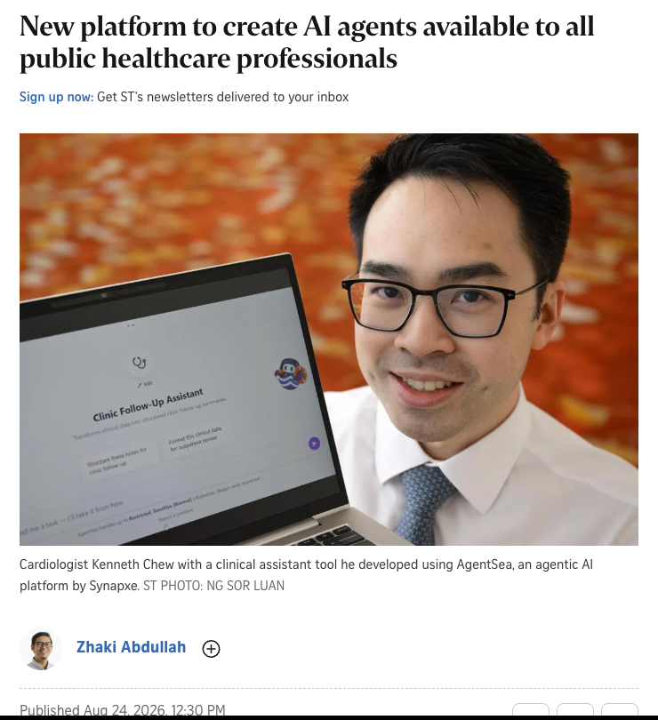


TOPIC 1 · SINGAPORE IN FOCUS
Singapore: 12,000+ AI Agents in Public Healthcare
AgentSea
Synapxe + AWS agentic AI platform for 80,000+ public healthcare professionals — launched end-May 2026.
12,000+ agents
Created by staff in natural language, little or no coding; 300+ shared for reuse.
Real impact
NHCS cardiologist halved pre-consultation prep; KKH agent generates daily rosters.
Guardrails
Patient-data protections built in — "not replaced the need for verification or my own clinical assessment".
▸ "We are moving from AI as assistant to AI as actor." — SMS Tan Kiat How, HIMSS26 APAC, 24 Aug 2026
Source: The Straits Times, "New platform to create AI agents available to all public healthcare professionals", Zhaki Abdullah, 24 Aug 2026.
© Tertiary Infotech Academy Pte Ltd
Human-AI Workforce with Autonomous AI Agents · TGS-2024043854
49

Slide 50

TOPIC 1 · SINGAPORE IN FOCUS
Singapore's Agentic AI Playbook
IMDA framework
Four dimensions
Model AI Governance Framework for Agentic AI — launched 22 Jan 2026 (Davos); updated v1.5 May 2026.
Bound risks upfront · meaningful human accountability · technical controls · end-user responsibility.
Public service
Healthcare
GovTech AI Assistant Desk with an agent registry (owner and purpose of each agent) for ~150,000 officers.
AgentSea plus MOH's AI in Healthcare Guidelines (AIHGle 2.0) — healthcare is a national AI mission.
TIP Course link: approval gates, budgets and audit logs (Labs 3, 7–10) are the 'human accountability' dimension in practice.
© Tertiary Infotech Academy Pte Ltd
Human-AI Workforce with Autonomous AI Agents · TGS-2024043854
50

Slide 51
TOPIC 1 · HUMAN–AI COLLABORATION IN ACTION
AI for Science — Agents Propose, Humans Decide
Use case | What the agent does | What the human does | Result
Google AI co-scientist (2025) | Multi-agent system generates, debates and ranks hypotheses | Sets the goal, picks hypotheses, runs wet-lab tests | 3 of 5 lab-tested leukaemia drug ideas worked
Edison Kosmos (2025) | Reads ~1,500 papers, writes ~42,000 lines of analysis code per run | Sets objective, judges which findings matter | 79% of statements judged accurate
Sakana AI Scientist (2025–26) | Idea → code → experiments → paper → review | Chooses the field, checks work, runs ethics review | 1 of 3 papers passed a workshop review
© Tertiary Infotech Academy Pte Ltd
Human-AI Workforce with Autonomous AI Agents · TGS-2024043854
51

Slide 52
TOPIC 1 · HUMAN–AI COLLABORATION IN ACTION
AI for Mathematics
Use case | What the agent does | What the human does | Result
AlphaProof + AlphaGeometry (2024) | Searches formal proofs in Lean | Formalises problems; graders score | IMO silver standard, 28/42
Gemini Deep Think (2025) | Writes natural-language proofs in 4.5 h | IMO coordinators grade and certify | IMO gold, 35/42 (certified)
AlphaEvolve (2025) | Evolves programs scored by an evaluator | Defines the problem and WRITES the evaluator | Improved best-known results in ~20% of 50+ problems
Terence Tao + AI (2025–26) | Searches constructions; proposes proofs (Erdős problems) | Chooses problems, checks and generalises | Real wins — mostly 'cheap wins', says Tao
© Tertiary Infotech Academy Pte Ltd
Human-AI Workforce with Autonomous AI Agents · TGS-2024043854
52

Slide 53
TOPIC 1 · HUMAN–AI COLLABORATION IN ACTION
Drug Discovery & Biology
Use case | What the AI does | What the human does | Status
AlphaFold 3 (2024) | Predicts structures of proteins, DNA, RNA and ligands | Forms hypotheses, chooses targets, validates in the lab | 2024 Nobel Prize in Chemistry (AlphaFold)
Insilico rentosertib (2025) | Found the TNIK target and designed the molecule | Clinicians ran the Phase 2a trial; regulators approved | Nature Medicine, Jun 2025 — safety met
Isomorphic Labs (2026) | In-house AI drug-design engine | Chemists, pharma partners, clinical teams | US$2.1B raised; first trials targeted end-2026
TIP Agents shorten discovery; humans still design the experiment, validate, and carry the clinical and ethical responsibility.
© Tertiary Infotech Academy Pte Ltd
Human-AI Workforce with Autonomous AI Agents · TGS-2024043854
53

Slide 54
TOPIC 1 · HUMAN–AI COLLABORATION IN ACTION
Business Functions
Function | Agent does | Human does | Evidence
Healthcare | MAI-DxO: virtual panel orders tests step by step | Clinician owns diagnosis and treatment | 85.5% on 304 NEJM cases (benchmark only)
Finance | Claude agents for trade accounting and client onboarding | Staff review exceptions and approve | Goldman Sachs + Anthropic, Feb 2026
Software | Codex writes code, tests, CI and docs | Engineers steer, review and build feedback loops | ~1M lines, no hand-written code (OpenAI)
Customer service | Handles routine chats in 35+ languages | Takes complex and sensitive cases | Klarna re-prioritised human access in 2025
Marketing | Drafts, designs, schedules and reports campaigns | Sets strategy, approves everything public | Labs 2–5 and 8–9 in this course
© Tertiary Infotech Academy Pte Ltd
Human-AI Workforce with Autonomous AI Agents · TGS-2024043854
54

Slide 55
TOPIC 1 · HUMAN–AI COLLABORATION IN ACTION
The Pattern Behind Every Success
The agent
The human
• Searches, generates, runs and checks — at scale
• Works 24/7 and in parallel
• Follows the rules it is given — exactly
• Never owns the consequence
• Sets the goal and defines 'good' (rubric, evaluator, tests)
• Approves consequential actions
• Interprets meaning and context
• Owns accountability — always
TIP Counter-evidence matters: a 2025 METR trial found experienced developers 19% SLOWER with early AI tools. The harness and the human make the difference.
© Tertiary Infotech Academy Pte Ltd
Human-AI Workforce with Autonomous AI Agents · TGS-2024043854
55

Slide 56

TOPIC 1 · RISKS & GOVERNANCE
Five Challenges for Trustworthy Agents
Toward agents that are trustworthy, controllable and sustainable.
Hallucination
Security risks
Explainability
Data & bias
Efficiency & cost
Confident but false facts → require citations and verifiers.
Prompt injection, poisoned skills, leaked keys → least privilege, secrets, sandboxes.
Why did it do that? → logs, Kanban history, audit trail.
Fairness, diversity, privacy (PDPA) → mask personal data, review outputs.
Tokens and runs add up → budgets, cheap models for simple roles.
© Tertiary Infotech Academy Pte Ltd
Human-AI Workforce with Autonomous AI Agents · TGS-2024043854
56

Slide 57

TOPIC 1 · RISKS & GOVERNANCE
Five Principles of AI Agent Security
Data control
Permission control
Human approval
Monitoring & audit
Kill switch
WHAT AI CAN SEE — classify data; give the agent only what it needs.
WHAT AI CAN DO — least privilege; read before write; approve before delete.
WHEN AI MUST ASK — gates for public, financial or irreversible actions.
WHAT AI DID — logs, costs, activity trail; review regularly.
HOW TO STOP IT — pause agents, revoke keys, `hermes pause`, Paperclip pause.
TIP Every lab applies at least one of these — look for them.
© Tertiary Infotech Academy Pte Ltd
Human-AI Workforce with Autonomous AI Agents · TGS-2024043854
57

Slide 58


TOPIC 1 · THE PLATFORMS
The Two Platforms You Will Use
"If OpenClaw is an employee, Paperclip is the company." Hermes is the employee that learns.
Hermes Agent
Paperclip
Day 1 · Labs 1–5
Day 2 · Labs 6–10
• Open source (MIT), Nous Research
• Self-improving: memory + skills it writes itself
• Telegram & 15+ channels, cron scheduler
• Profiles + Kanban for multi-agent teams
• Open source (MIT), self-hosted
• Company: Board → CEO → specialists (org chart)
• Issues, routines, heartbeats
• Budgets, approval gates, immutable audit log
© Tertiary Infotech Academy Pte Ltd
Human-AI Workforce with Autonomous AI Agents · TGS-2024043854
58

Slide 59

TOPIC 1 · ACTIVITY
Activity — Human–AI Workforce Canvas
In pairs, 15 minutes. Then start the Hermes Agent install so it is ready for Lab 1.
1. List the work
2. Single agent?
3. Agent team?
Write 8–10 tasks in Kopi Kaki's #ShiokColdBrew campaign (research, posts, video, replies, reporting …).
Mark tasks one Hermes agent can do end to end.
Mark tasks that need several specialised agents (pipeline or swarm).
4. Human?
5. Checkpoints
6. Start Hermes
Mark decisions that must stay human — and why (risk, accountability, judgement).
Draw where the human approves: before public posts, refunds, spend.
Run the installer now (Lab 1 step 1) — it downloads while we debrief.
© Tertiary Infotech Academy Pte Ltd
Human-AI Workforce with Autonomous AI Agents · TGS-2024043854
59

Slide 60

TOPIC 1 · ACTIVITY
Optional — Ask Hermes to Critique Your Canvas
PROMPT · copy from the Lab Prompts page
Uses Hermes
Here is our Human-AI Workforce Canvas for Kopi Kaki Co.'s #ShiokColdBrew campaign:
<paste your task list with SINGLE / TEAM / HUMAN labels and approval checkpoints>
Act as an operations consultant. For each task:
1. Agree or disagree with our label and say why (risk, reversibility, volume, judgement).
2. Suggest the autonomy level (L1 Operator ... L5 Observer).
3. Name one control (approval gate, budget, audit, verifier) we must add.
End with the 3 biggest risks in our design.
Once installed, paste this into the Hermes chat — your first agent conversation.
Compare
Where does the agent disagree with you? Who is right?
Keep it
You will build this exact workforce in Labs 1–10.
© Tertiary Infotech Academy Pte Ltd
Human-AI Workforce with Autonomous AI Agents · TGS-2024043854
60

Slide 61
TOPIC 2
1
Lab 1 · Your first AI employee
Hermes Agent — From a Single AI Employee to a Multi-Agent Team
2
Lab 2 · End-to-end social media campaign
3
Lab 3 · Human-in-the-loop publishing
4
Lab 4 · Multi-agent video studio
5
Lab 5 · Campaign command centre
Day 1 — from one AI employee to a supervised multi-agent team.
© Tertiary Infotech Academy Pte Ltd · TGS-2024043854

Slide 62


TOPIC 2 · HERMES AGENT
What Is Hermes Agent?
"The agent that grows with you." — 255k+ GitHub stars, v0.22 (Oct 2026).
Open source, self-hosted
Grows with you
Every channel
MIT licence by Nous Research. Runs on your laptop, a VPS, Docker or the desktop app.
Persistent memory and session search; writes and improves its own skills after hard tasks.
One gateway: CLI, Telegram, WhatsApp, Slack, Discord, Signal, email …
Tools & MCP
Proactive
Multi-agent
Web search, files, terminal, browser, image generation, TTS and any MCP server.
Built-in cron scheduler runs jobs and delivers results to your chat.
Profiles (isolated agents) + a Kanban board with dependencies, reviews and swarms.
© Tertiary Infotech Academy Pte Ltd
Human-AI Workforce with Autonomous AI Agents · TGS-2024043854
62

Slide 63
TOPIC 2 · HERMES AGENT
Hermes Architecture — the Harness Around the Model
Context
AGENTS.md, SOUL.md, USER.md
Cron · Profiles · Kanban
Memory
schedule & orchestrate
MEMORY.md + session search
Hermes agent loop
+ your LLM
Gateway
Skills
Telegram, Slack, WhatsApp …
SKILL.md, hub + self-written
Tools & MCP
web, files, terminal, images
© Tertiary Infotech Academy Pte Ltd
Human-AI Workforce with Autonomous AI Agents · TGS-2024043854
63

Slide 64

TOPIC 2 · HERMES AGENT
The Hermes Dashboard
▸ `hermes dashboard` opens http://127.0.0.1:9119 — sessions, skills, profiles, Kanban, cron, channels and keys in one place.
© Tertiary Infotech Academy Pte Ltd
Human-AI Workforce with Autonomous AI Agents · TGS-2024043854
64

Slide 65
TOPIC 2 · DAY 1 JOURNEY
Day 1: Single Agent → Multi-Agent → Human Gates
STEP 1
STEP 2
STEP 3
STEP 4
STEP 5
Lab 1
Lab 2
Lab 3
Lab 4
Lab 5
First AI employee — research brief, memory.
Social media campaign — skills + tools.
Human-in-the-loop on Telegram + cron.
5-agent video studio with a human gate.
Swarm analysis, dashboard, decisions.
TIP Each lab saves to ~/kopi-kaki/outputs/labNN — the next lab builds on it.
© Tertiary Infotech Academy Pte Ltd
Human-AI Workforce with Autonomous AI Agents · TGS-2024043854
65

Slide 66
TOPIC 2 · DAY 1 JOURNEY
The Kopi Kaki Company Pack (data/ in every lab)
File | What it is | Used in
AGENTS.md | Company context Hermes loads automatically from the folder | All labs
brand-guide.md · campaign-brief.md | Voice, colours, formats · product, offer, KPIs, timeline | All labs
compliance-rules.md · video-qa-checklist.md | C1–C10 brand-safety rules · V1–V9 video checks | Labs 2–5, 8–9
customer-reviews.csv · competitors.csv | 60 synthetic reviews · 6 fictional competitors | Labs 1, 5
social-comments.csv | 20 comments incl. complaints, legal, PII, spam | Labs 3, 5
campaign-week1-metrics.csv · sales-by-outlet.csv | Post metrics and outlet sales for week 1 | Lab 5
skills/ · souls/ · tasks/ · DESIGN.md | Ready-made skills, agent roles, task briefs, visual identity | Labs 2, 4, 5
© Tertiary Infotech Academy Pte Ltd
Human-AI Workforce with Autonomous AI Agents · TGS-2024043854
66

Slide 67
TOPIC 2 · LAB 1
Lab 1 — Hire Your First AI Employee — Customer & Market Research Brief
Install Hermes, give it company context and long-term memory, and let one agent turn raw reviews and live web research into a brief you can act on.
The business scenario
You will deliver
✓ outputs/lab01/review-insights.md — ratings, themes and evidence (review IDs)
✓ outputs/lab01/research-brief.md — trends, competitors, 3 campaign angles with evidence
✓ Mia's long-term memory holds the brand facts and YOUR chosen angle (recalled in a new session)
You are Kopi Kaki Co.'s Marketing Lead. The Gula Melaka Cold Brew launches on 1 Dec and you have 60 unread customer reviews, a competitor list and no analyst. You 'hire' Mia — a Hermes Agent marketing analyst — onboard her with the company context, and ask for a research brief that tells you which campaign angle to run.
Agents 1 Hermes agent — 'Mia', AI marketing analyst
Human role Set the goal, challenge the evidence, choose the campaign angle
Time 55 min · Single agent · labs/lab01-hermes-first-ai-employee/
© Tertiary Infotech Academy Pte Ltd
Human-AI Workforce with Autonomous AI Agents · TGS-2024043854
67

Slide 68

TOPIC 2 · LAB 1
Lab 1 — How the workflow runs
Perception → reasoning → action, with you at the checkpoints.
AGENT · STEP 1
AGENT · STEP 2
AGENT · STEP 3
AGENT · STEP 4
HUMAN · STEP 5
AGENT · STEP 6
Install & onboard
Remember the brand
Perceive
Reason
Decide
Recall
Install Hermes, pick a ≥64k-context model, load AGENTS.md.
Save brand facts to long-term memory.
Read 60 reviews + search the web for 2026 trends.
Find themes, compare competitors, draft 3 angles.
Challenge one claim, choose the angle.
New session: Mia remembers your decision.
Checkpoint Every insight cites review IDs or a URL; the angle you chose is recalled in a brand-new session.
© Tertiary Infotech Academy Pte Ltd
Human-AI Workforce with Autonomous AI Agents · TGS-2024043854
68

Slide 69
TOPIC 2 · LAB 1
Install, Connect a Model, Start in the Workspace
TERMINAL · copy from the Lab Prompts page
Install
curl -fsSL https://hermes-agent.nousresearch.com/install.sh | bash
# Windows PowerShell: iex (irm https://hermes-agent.nousresearch.com/install.ps1)
source ~/.zshrc # or ~/.bashrc — puts 'hermes' on your PATH
macOS / Linux / WSL2 one-liner; Windows PowerShell installer.
hermes setup
Pick a provider and a model with ≥ 64k context; `hermes doctor` to check.
Start in ~/kopi-kaki
AGENTS.md there is loaded automatically.
© Tertiary Infotech Academy Pte Ltd
Human-AI Workforce with Autonomous AI Agents · TGS-2024043854
69

Slide 70
TOPIC 2 · LAB 1
Context & Memory Files in Hermes
File | Scope | What goes in it | Loaded
AGENTS.md (project) | This folder | Company facts, rules, current priority | Every session started in the folder
SOUL.md | ~/.hermes/ (per profile) | The agent's role, personality and standing rules | Every session
MEMORY.md | ~/.hermes/memories/ | Facts the agent decides to remember (~2,200 chars) | Session start
USER.md | ~/.hermes/memories/ | What it knows about you and your preferences | Session start
Session history | state database | Every past conversation — searchable | On demand (session search)
TIP Short-term = this session's context window. Long-term = the files and history above.
© Tertiary Infotech Academy Pte Ltd
Human-AI Workforce with Autonomous AI Agents · TGS-2024043854
70

Slide 71
TOPIC 2 · LAB 1
Onboard Mia — persona and long-term memory
PROMPT · copy from the Lab Prompts page
Paste into
You are Mia, Kopi Kaki Co.'s AI marketing analyst. Read AGENTS.md, brand-guide.md and campaign-brief.md in this folder.
Save these facts to your long-term memory:
- Kopi Kaki Co.: Singapore kopi chain, 12 outlets, positioning "Heritage kopi, modern craft".
- Launch: Gula Melaka Cold Brew, SGD 6.80, launches 1 Dec 2026, campaign #ShiokColdBrew 17 Nov - 14 Dec.
- Promo SHIOK20: 20% off the first Gula Melaka Cold Brew ordered in the app, valid 1-14 Dec 2026, one per customer.
- Never publish anything without my APPROVE. Never make health or halal claims.
Then summarise the company in 5 bullets and ask me the 3 questions a new analyst should ask on day one.
Hermes chat (started inside ~/kopi-kaki)
Expect
Mia confirms the memory was saved and returns 5 bullets + 3 questions. Check the file itself: `cat ~/.hermes/memories/MEMORY.md` shows the facts.
You decide
Set the goal, challenge the evidence, choose the campaign angle
© Tertiary Infotech Academy Pte Ltd
Human-AI Workforce with Autonomous AI Agents · TGS-2024043854
71

Slide 72
TOPIC 2 · LAB 1
Perceive the data — analyse 60 customer reviews
PROMPT · copy from the Lab Prompts page
Paste into
Analyse customer-reviews.csv.
1. Rating distribution (count and % for 1-5 stars) and average rating per outlet.
2. The top 5 praise themes and top 5 complaint themes, each with a count and 2 example review_ids.
3. Anything relevant to a cold-brew launch (mentions of cold brew, sweetness, oat milk, app).
Show your calculation method. Save the result as outputs/lab01/review-insights.md.
Hermes chat
Expect
A Markdown report with a ratings table and themes that cite review IDs (e.g. R1012).
You decide
Set the goal, challenge the evidence, choose the campaign angle
© Tertiary Infotech Academy Pte Ltd
Human-AI Workforce with Autonomous AI Agents · TGS-2024043854
72

Slide 73
TOPIC 2 · LAB 1
Lab 1 — Checkpoint & Reflection
Verify
outputs/lab01/review-insights.md and research-brief.md exist and cite review IDs / URLs
Verify
The brief ends with a decision log naming the angle you chose
Verify
MEMORY.md contains the brand facts and your decision
Concepts in action
Perception (files + web) → Brain (LLM reasoning, memory) → Action (write files) · AGENTS.md = context the agent loads automatically (context engineering)
Stretch challenge
Ask Mia: "Save the review-analysis procedure you just used as a reusable skill called review-insights." Then run `hermes skills list` — a self-improving agent turns experience into procedural memory.
© Tertiary Infotech Academy Pte Ltd
Human-AI Workforce with Autonomous AI Agents · TGS-2024043854
73

Slide 74
TOPIC 2 · LAB 2
Lab 2 — End-to-End Social Media Campaign with One Agent
Give the agent two company skills and one tool chain, and turn the brief into a complete, dated, on-brand multi-platform campaign — then improve it with your feedback.
The business scenario
You will deliver
✓ outputs/lab02/campaign-plan.md — strategy, pillars, phases, KPIs, budget split
✓ outputs/lab02/content-calendar.csv — ≥ 16 dated posts with UTM links
✓ outputs/lab02/captions.md — captions with a compliance self-check per post
✓ outputs/lab02/images/ — 3 hero visuals (or image prompts if no image tool)
✓ A revised v2 after your feedback
With the angle chosen, you need a campaign: strategy, a 14-day content calendar across Instagram, TikTok, Facebook and LinkedIn, captions in the Kopi Kaki voice, visuals and tracking links. Instead of a long prompt you give Mia two skills — the company's brand-voice skill and a campaign-planner skill — so the work is repeatable and self-checked.
Agents 1 Hermes agent (Mia) + 2 custom skills + image tool
Human role Review the draft, give concrete feedback, accept v2
Time 60 min · Single agent + skills · labs/lab02-hermes-social-media-campaign/
© Tertiary Infotech Academy Pte Ltd
Human-AI Workforce with Autonomous AI Agents · TGS-2024043854
74

Slide 75


TOPIC 2 · LAB 2
Lab 2 — How the workflow runs
Perception → reasoning → action, with you at the checkpoints.
AGENT · STEP 1
AGENT · STEP 2
AGENT · STEP 3
AGENT · STEP 4
HUMAN · STEP 5
AGENT · STEP 6
Install skills
Plan
Calendar
Create
Review
Revise
Add kopi-brand-voice and social-campaign-planner.
Strategy, pillars, phases, KPI mapping.
16+ dated posts, platform formats, UTMs.
Captions + hero visuals with self-check.
You give 3 concrete change requests.
v2 applies the feedback and re-checks.
Checkpoint Every caption carries a PASS self-check; no health/halal claims; SHIOK20 always shows its terms.
© Tertiary Infotech Academy Pte Ltd
Human-AI Workforce with Autonomous AI Agents · TGS-2024043854
75

Slide 76
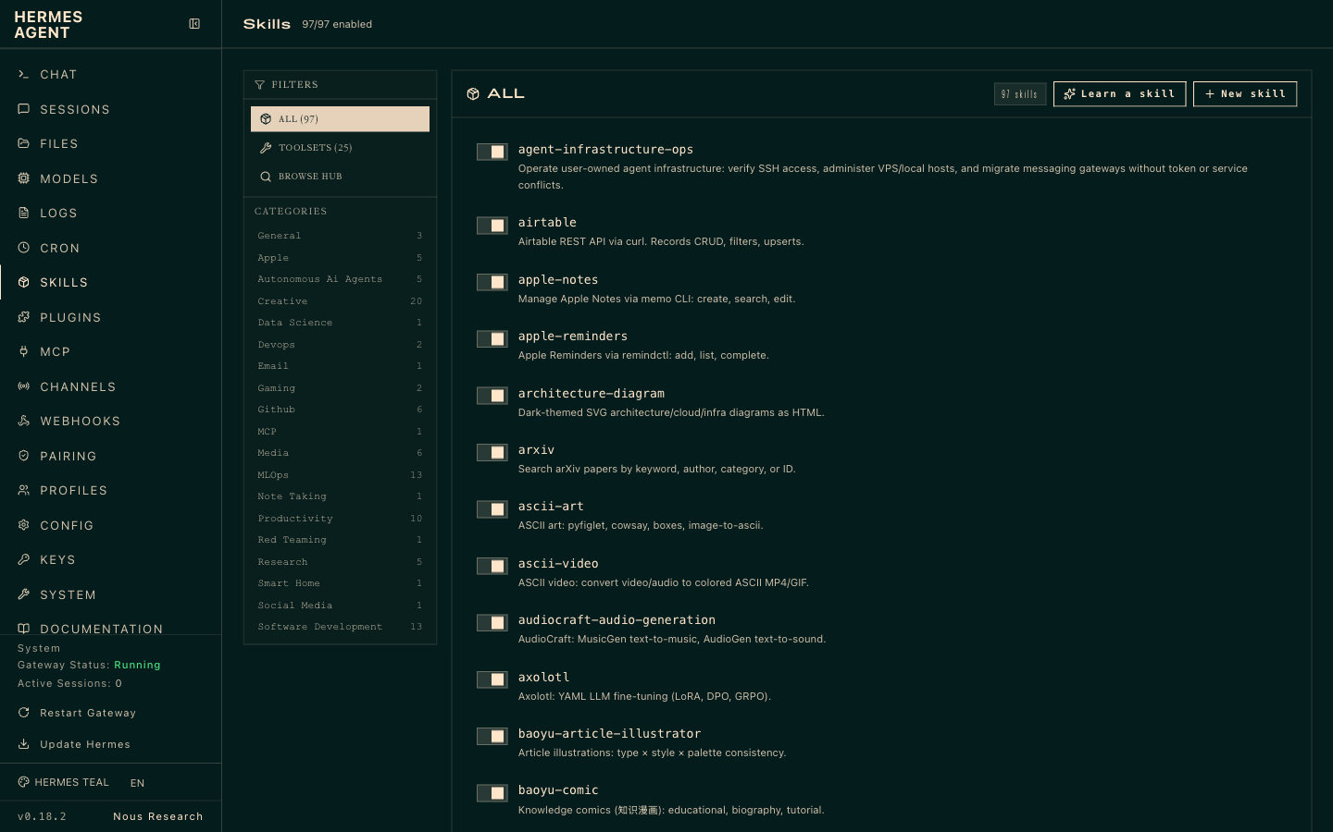
TOPIC 2 · LAB 2
Skills on the Hermes Dashboard
▸ Skills are folders with a SKILL.md — bundled, from the hub (`hermes skills install`), your own, or written by the agent itself.
© Tertiary Infotech Academy Pte Ltd
Human-AI Workforce with Autonomous AI Agents · TGS-2024043854
76

Slide 77
TOPIC 2 · LAB 2
Anatomy of a Skill — kopi-brand-voice/SKILL.md
SKILL.md · in labs/lab02-…/data/skills/
description
---
name: kopi-brand-voice
description: Write or rewrite public-facing copy in the
Kopi Kaki voice and check it against the compliance rules.
---
# Kopi Kaki brand voice
## Steps
1. Read brand-guide, campaign-brief, compliance-rules.
2. Warm and sensory; max 1 Singlish word, max 2 emojis.
3. Only facts and prices from the brief or catalogue.
4. Promo code shown? Add its terms.
5. Run the self-check; fix every FAIL.
## Self-check: C1 health · C3 promo · C4 halal · C9 AI
Tells the agent WHEN to load the skill — costs no context until used.
steps
An SOP the agent follows the same way every time.
self-check
Verification built into the skill — the loop checks itself.
© Tertiary Infotech Academy Pte Ltd
Human-AI Workforce with Autonomous AI Agents · TGS-2024043854
77

Slide 78
TOPIC 2 · LAB 2
Build the campaign plan and calendar
PROMPT · copy from the Lab Prompts page
Paste into
Use the social-campaign-planner skill to build the #ShiokColdBrew campaign from campaign-brief.md, using the angle I chose in Lab 1 (check your memory).
Scope: teaser (17-23 Nov) and pre-order push (24-30 Nov) phases, Instagram, TikTok, Facebook and LinkedIn.
Deliver:
- outputs/lab02/campaign-plan.md
- outputs/lab02/content-calendar.csv with at least 16 posts (use the columns in the skill)
- outputs/lab02/captions.md with every caption checked by the kopi-brand-voice skill
End with a 5-line summary of decisions you need from me.
Hermes chat in ~/kopi-kaki
Expect
Three files in outputs/lab02 and a decisions summary.
You decide
Review the draft, give concrete feedback, accept v2
© Tertiary Infotech Academy Pte Ltd
Human-AI Workforce with Autonomous AI Agents · TGS-2024043854
78

Slide 79
TOPIC 2 · LAB 2
Create the hero visuals
PROMPT · copy from the Lab Prompts page
Paste into
Create 3 hero visuals for the teaser posts using your image generation tool: square 1:1, brand colours (kopi brown #5B3A29, pandan green #4E8A3E, cream #F6EBD9, gula melaka amber #C7782A), natural light, a glass of iced cold brew with a gula melaka drizzle, kopitiam tiles, no people's faces, no text in the image. Save them to outputs/lab02/images/ and add the file names to content-calendar.csv. If you have no image tool, write the 3 prompts to outputs/lab02/images/prompts.md instead.
Hermes chat
Expect
3 PNGs (or a prompts file) linked from the calendar.
You decide
Review the draft, give concrete feedback, accept v2
© Tertiary Infotech Academy Pte Ltd
Human-AI Workforce with Autonomous AI Agents · TGS-2024043854
79

Slide 80
TOPIC 2 · LAB 2
Lab 2 — Checkpoint & Reflection
Verify
campaign-plan.md, content-calendar(-v2).csv and captions(-v2).md exist in outputs/lab02
Verify
≥ 16 posts across 4 platforms with UTM links; LinkedIn has no promo code
Verify
Each caption has a PASS self-check table
Concepts in action
Skills = procedural memory: a SKILL.md the agent loads on demand · Tools = actions: file write, web search, image generation
Stretch challenge
Ask Mia to turn your three review comments into permanent rules by patching the kopi-brand-voice skill ("update the skill so this mistake never happens again") — that is harness engineering in one sentence.
© Tertiary Infotech Academy Pte Ltd
Human-AI Workforce with Autonomous AI Agents · TGS-2024043854
80

Slide 81
TOPIC 2 · LAB 3
Lab 3 — Human-in-the-Loop Publishing & Community Care (Telegram + Cron)
Put the agent on Telegram, make it ask for your APPROVE before anything goes public, schedule it every morning, and let it triage comments while escalating the risky ones to you.
The business scenario
You will deliver
✓ A Telegram bot connected to Hermes (your private chat with Mia)
✓ A 'Kopi Kaki Feed (Training)' Telegram channel where approved posts are published
✓ outputs/lab03/approval-log.csv — every APPROVE / EDIT / REJECT decision
✓ A daily 09:00 cron job that sends the day's post for approval
✓ outputs/lab03/moderation-queue.csv + an escalation summary on Telegram
The campaign is planned; now it must run every day without you babysitting it. Each morning Mia sends you the day's post and image on Telegram. Only when you reply APPROVE does she publish it to the brand's Telegram channel and log it. She also works through the comment inbox — answering simple questions, but escalating food-safety, allergy, legal, billing, media and halal questions to you with personal data masked.
Agents 1 Hermes agent (Mia) on the messaging gateway + cron scheduler
Human role Approve, edit or reject every post; decide every escalation
Time 45 min · Human–agent collaboration · labs/lab03-hermes-human-in-the-loop/
© Tertiary Infotech Academy Pte Ltd
Human-AI Workforce with Autonomous AI Agents · TGS-2024043854
81

Slide 82

TOPIC 2 · LAB 3
Lab 3 — How the workflow runs
Perception → reasoning → action, with you at the checkpoints.
AGENT · STEP 1
AGENT · STEP 2
HUMAN · STEP 3
AGENT · STEP 4
AGENT · STEP 5
HUMAN · STEP 6
Connect
Propose
Approve
Publish
Triage
Decide
Telegram bot + allow-listed user ID.
09:00 cron sends the day's post + image.
You reply APPROVE / EDIT / REJECT.
Approved post goes to the channel; logged.
Answer FAQs, mask PII, escalate risks.
You resolve each escalation.
Checkpoint Nothing reaches the channel without an APPROVE in approval-log.csv; all 7 risky comments are escalated, none answered.
© Tertiary Infotech Academy Pte Ltd
Human-AI Workforce with Autonomous AI Agents · TGS-2024043854
82

Slide 83
TOPIC 2 · LAB 3
Connect Telegram in Five Steps
STEP 1
STEP 2
STEP 3
STEP 4
STEP 5
@BotFather
@userinfobot
hermes gateway setup
hermes gateway run
Brand channel
/newbot → name → copy the token (keep it secret).
Copy your numeric Telegram user ID.
Choose Telegram, paste token + your ID as the only allowed user.
Leave it running — it hosts chat, cron and Kanban dispatch.
Create 'Kopi Kaki Feed (Training)'; add the bot as admin.
TIP Shortcut: Dashboard → Messaging → Telegram → 'Create with QR'. NEVER share the bot token.
© Tertiary Infotech Academy Pte Ltd
Human-AI Workforce with Autonomous AI Agents · TGS-2024043854
83

Slide 84
TOPIC 2 · LAB 3
Escalation Rules — Policy Becomes Agent Behaviour
Comment type | Agent action | Why
FAQ (availability, oat milk, outlets) | REPLY — draft in brand voice | Low risk, high volume
Spam | IGNORE | No value; don't engage
Food safety / allergy (C06, C16) | ESCALATE — no public reply | Health and legal risk
Legal threat / media (C18, C11) | ESCALATE | Needs a human spokesperson
Billing / refund (C09) | ESCALATE | Money and policy decisions
Halal / health questions (C03, C15) | ESCALATE | Claims we must not make (C1, C4)
TIP Personal data (names, phone numbers) is masked before anything reaches you or a public reply.
© Tertiary Infotech Academy Pte Ltd
Human-AI Workforce with Autonomous AI Agents · TGS-2024043854
84

Slide 85
TOPIC 2 · LAB 3
Make It Proactive — the 09:00 Approval Cron
TERMINAL · copy from the Lab Prompts page
Schedule
hermes cron create "0 9 * * *" "Proposal only - never publish. Take the next post with status draft from ~/kopi-kaki/outputs/lab02/content-calendar-v2.csv, set it to pending-approval and send me its post id, image, platform, date and caption, ending with: Reply APPROVE <post_id>, EDIT <post_id>: <changes> or REJECT <post_id>." --name daily-post-approval --deliver telegram
hermes cron list
hermes cron run <job_id>
Cron syntax '0 9 * * *' = every day at 09:00.
--deliver telegram
Results arrive in your Telegram chat.
Still gated
The job proposes; only your APPROVE publishes.
© Tertiary Infotech Academy Pte Ltd
Human-AI Workforce with Autonomous AI Agents · TGS-2024043854
85

Slide 86
TOPIC 2 · LAB 3
Run one approval cycle by hand
PROMPT · copy from the Lab Prompts page
Paste into
Approval workflow for #ShiokColdBrew (standing rule - add it to ~/kopi-kaki/AGENTS.md too):
1. Take the next post with status "draft" from ~/kopi-kaki/outputs/lab02/content-calendar-v2.csv, set its status to "pending-approval" and send it to me here with its post id, image, platform and date. End with: Reply APPROVE <post_id>, EDIT <post_id>: <changes> or REJECT <post_id>.
2. Whenever I reply APPROVE <post_id>, read that row from the CSV - it must say "pending-approval" - then post the caption and image to telegram:<channel_id>, set the status to "published" and append a row to ~/kopi-kaki/outputs/lab03/approval-log.csv.
3. EDIT: apply my changes, re-check with kopi-brand-voice, keep "pending-approval" and send it again. REJECT: set "rejected" and log it.
4. Never publish a row that is not "pending-approval" and never without my APPROVE.
Telegram → your bot
Expect
You receive the draft with its post id; after APPROVE <post_id> it appears in the channel, the CSV says published and approval-log.csv has a row.
You decide
Approve, edit or reject every post; decide every escalation
© Tertiary Infotech Academy Pte Ltd
Human-AI Workforce with Autonomous AI Agents · TGS-2024043854
86

Slide 87
TOPIC 2 · LAB 3
Triage the comment inbox with escalation rules
PROMPT · copy from the Lab Prompts page
Paste into
Triage ~/kopi-kaki/social-comments.csv using compliance-rules.md.
For each comment decide: REPLY (safe FAQ), IGNORE (spam) or ESCALATE (food safety, allergy, legal threat, billing/refund, media enquiry, halal question, health claim question, anything uncertain).
- For REPLY: draft a reply in the kopi-brand-voice skill.
- For ESCALATE: do NOT draft a public reply. Mask all personal data (names, phone numbers) and recommend the next step.
Save outputs/lab03/moderation-queue.csv (comment_id, decision, reason, draft_reply) and send me an escalation summary here.
Telegram → your bot (or Hermes chat in ~/kopi-kaki)
Expect
7 escalations summarised on Telegram with phone numbers masked; safe replies drafted.
You decide
Approve, edit or reject every post; decide every escalation
© Tertiary Infotech Academy Pte Ltd
Human-AI Workforce with Autonomous AI Agents · TGS-2024043854
87

Slide 88
TOPIC 2 · LAB 3
Lab 3 — Checkpoint & Reflection
Verify
Bot replies only to your allow-listed user ID
Verify
Every published post has an APPROVE row in approval-log.csv and its CSV status went pending-approval → published
Verify
`hermes cron list` shows daily-post-approval
Concepts in action
Human-in-the-loop (approve before acting) vs human-on-the-loop (monitor and intervene) · Escalation rules turn policy into agent behaviour
Stretch challenge
Add a second gate: a post that mentions a price or promo must be approved twice (you and a colleague's Telegram ID). How would you express that rule, and what does it cost in speed?
© Tertiary Infotech Academy Pte Ltd
Human-AI Workforce with Autonomous AI Agents · TGS-2024043854
88

Slide 89
TOPIC 2 · LAB 4
Lab 4 — Multi-Agent Video Studio — Research → Script → Production → Audit → Publish
Build a five-agent production team on the Kanban board, render a real 25-second vertical video with HyperFrames, let an auditor agent check it, and approve it yourself before it publishes.
The business scenario
You will deliver
✓ 5 Hermes profiles with routing descriptions (researcher, scriptwriter, producer, auditor, publisher)
✓ A Kanban task graph with dependencies and a human gate before publishing
✓ video-studio/research.md, script.md (scene list), output/final.mp4 (9:16)
✓ video-studio/audit-report.md — PASS/FAIL on V1–V9 and C1–C10
✓ video-studio/publish-package.md, reviewed by you, then the video posted once to your Telegram channel
The campaign needs a 25-second TikTok/Reels launch video. One agent doing everything is slow, expensive and hard to review, so you staff a studio: a researcher finds the hook, a scriptwriter writes it, a producer renders it, an auditor checks it against the brand and compliance rules, and a publisher prepares and posts it — but only after you approve the cut.
Agents 5 Hermes profiles coordinated by the Kanban board
Human role Review the cut and the publish package, then release the posting task (or send it back with comments)
Time 60 min · Multi-agent (ordered pipeline) · labs/lab04-hermes-multi-agent-video-studio/
© Tertiary Infotech Academy Pte Ltd
Human-AI Workforce with Autonomous AI Agents · TGS-2024043854
89

Slide 90
TOPIC 2 · LAB 4
Lab 4 — How the workflow runs
Perception → reasoning → action, with you at the checkpoints.
AGENT · STEP 1
AGENT · STEP 2
AGENT · STEP 3
AGENT · STEP 4
HUMAN · STEP 5
AGENT · STEP 6
Research
Script
Produce
Audit
Approve
Post
Hooks, trends, proof points (cited).
25 s script + 6-scene list.
HyperFrames render → final.mp4.
V1–V9, C1–C10 → PASS / FAIL.
Review cut + package; unblock.
Posted once to the channel.
Checkpoint final.mp4 is 9:16 and 20–30 s, the audit is PASS, and the posting task only ran after you reviewed the package and unblocked it.
© Tertiary Infotech Academy Pte Ltd
Human-AI Workforce with Autonomous AI Agents · TGS-2024043854
90

Slide 91
TOPIC 2 · LAB 4
Your Video Studio Team
researcher
hooks + proof points → research.md
You
scriptwriter
watch the cut · unblock or comment
25-s script + 6 scenes → script.md
Kanban board
(orchestrator)
publisher
producer
runs only after you unblock
HyperFrames → output/final.mp4
auditor
V1–V9, C1–C10 → audit-report.md
TIP The profile --description is the routing contract; SOUL.md holds each role's rules.
© Tertiary Infotech Academy Pte Ltd
Human-AI Workforce with Autonomous AI Agents · TGS-2024043854
91

Slide 92
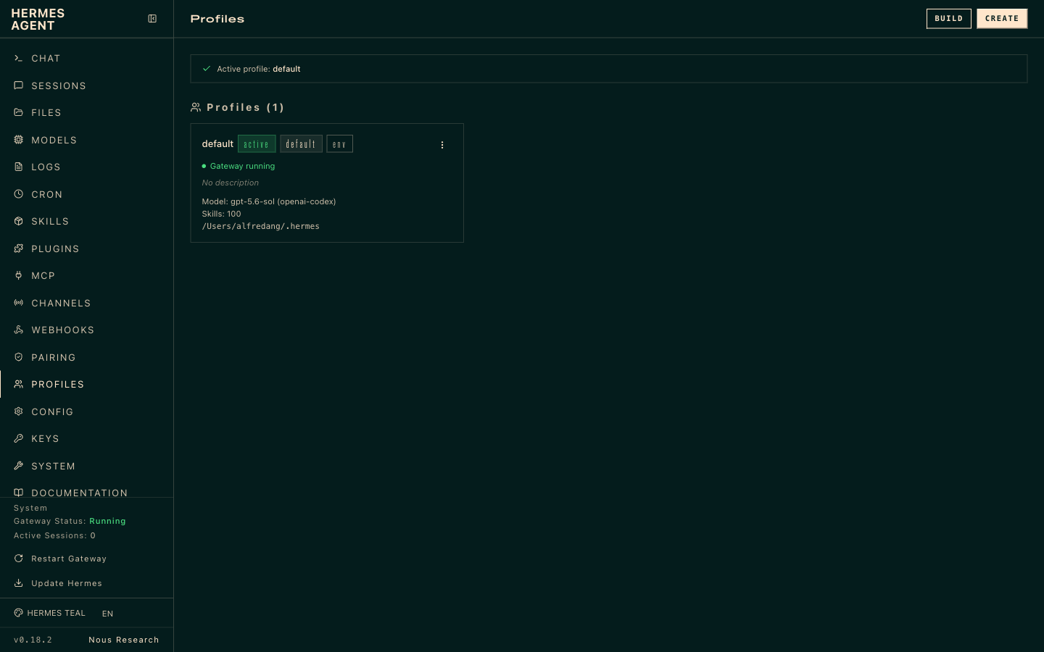
TOPIC 2 · LAB 4
Profiles — Isolated Agents with Their Own Memory
▸ `hermes profile create <name> --clone --description "…"` — each profile has its own SOUL.md, memory, skills and sessions.
© Tertiary Infotech Academy Pte Ltd
Human-AI Workforce with Autonomous AI Agents · TGS-2024043854
92

Slide 93

TOPIC 2 · LAB 4
Build the Task Graph with a Human Gate
TERMINAL · copy from the Lab Prompts page
--parent
S=dir:$HOME/kopi-kaki/video-studio
hermes kanban create "Research hooks for the Gula Melaka Cold Brew launch short" --assignee researcher --workspace $S --tenant kopi-video --body-file ~/kopi-kaki/tasks/t1-research.md
hermes kanban create "Write the 25-second script and scene list" --assignee scriptwriter --parent <T1> --workspace $S --tenant kopi-video --body-file ~/kopi-kaki/tasks/t2-script.md
hermes kanban create "Render the 9:16 launch video with HyperFrames" --assignee producer --parent <T2> --workspace $S --tenant kopi-video --skill hyperframes --max-runtime 45m --body-file ~/kopi-kaki/tasks/t3-produce.md
hermes kanban create "Audit the video and copy (V1-V9, C1-C10)" --assignee auditor --parent <T3> --workspace $S --tenant kopi-video --skill brand-compliance-audit --body-file ~/kopi-kaki/tasks/t4-audit.md
hermes kanban create "Build the publish package (do not post)" --assignee publisher --parent <T4> --workspace $S --tenant kopi-video --body-file ~/kopi-kaki/tasks/t5-package.md
hermes kanban create "Post the approved video to the channel" --assignee publisher --parent <T5> --workspace $S --tenant kopi-video --initial-status blocked --body-file ~/kopi-kaki/tasks/t6-post.md
Each task waits for the one before — an ordered SOP.
dir: workspace
All stages share ~/kopi-kaki/video-studio.
--initial-status blocked
Publishing waits for your `hermes kanban unblock`.
© Tertiary Infotech Academy Pte Ltd
Human-AI Workforce with Autonomous AI Agents · TGS-2024043854
93

Slide 94

TOPIC 2 · LAB 4
Watch the Board
▸ Lanes: triage → todo → ready → running → review → done. A FAIL goes back with `hermes kanban request-changes`.
© Tertiary Infotech Academy Pte Ltd
Human-AI Workforce with Autonomous AI Agents · TGS-2024043854
94

Slide 95
TOPIC 2 · LAB 4
Reflect — why a team beats one big agent
PROMPT · copy from the Lab Prompts page
Paste into
Read the Kanban history for tenant kopi-video (hermes kanban show for each task). Report per stage: which profile ran it, how long it took, how many retries or change requests it needed, and what was handed to the next stage. Then compare this five-agent design with a single agent doing everything: quality, cost, speed, reviewability.
Hermes chat
Expect
A stage-by-stage table you can use in the assessment.
You decide
Review the cut and the publish package, then release the posting task (or send it back with comments)
© Tertiary Infotech Academy Pte Ltd
Human-AI Workforce with Autonomous AI Agents · TGS-2024043854
95

Slide 96
TOPIC 2 · LAB 4
Lab 4 — Checkpoint & Reflection
Verify
`hermes profile list` shows the five roles
Verify
final.mp4 is 1080×1920, 20–30 s (`ffprobe` or the auditor's report)
Verify
audit-report.md is PASS (or shows a FAIL that was fixed via request-changes)
Concepts in action
Agentic AI = several specialised agents + orchestration (vs one AI agent) · Profile description = routing contract; SOUL.md = role + rules
Stretch challenge
Shortcut: install `official/creative/kanban-video-orchestrator`, give it the brief, and compare the team it designs with yours. Which roles did it add or merge?
© Tertiary Infotech Academy Pte Ltd
Human-AI Workforce with Autonomous AI Agents · TGS-2024043854
96

Slide 97
TOPIC 2 · LAB 5
Lab 5 — Multi-Agent Campaign Command Centre — Measure, Optimise & Report
Run three analysts in parallel, have a verifier check their numbers, and get a dashboard plus an optimisation plan you approve — then schedule it every Monday.
The business scenario
You will deliver
✓ outputs/lab05/dashboard.html — KPI cards + charts (opens in a browser)
✓ outputs/lab05/optimisation-plan.md — 3 proposals with evidence, impact, risk
✓ outputs/lab05/verification.md — the verifier's re-calculation of the key numbers
✓ Your decision recorded on the swarm task
✓ A Monday 09:00 cron that delivers the weekly report to Telegram
Week 1 of #ShiokColdBrew is over. Leadership wants to know: are we on track for 2,500 pre-orders, which posts work, what customers are saying and what competitors are doing? You launch a Kanban swarm — three parallel workers, a verifier that re-checks their numbers, and a synthesiser that builds the dashboard and recommendations. You decide which optimisations to apply.
Agents 3 parallel workers + verifier + synthesiser (Kanban swarm)
Human role Spot-check one number yourself; approve which optimisations to run
Time 45 min · Multi-agent (parallel swarm) · labs/lab05-hermes-campaign-command-centre/
© Tertiary Infotech Academy Pte Ltd
Human-AI Workforce with Autonomous AI Agents · TGS-2024043854
97

Slide 98
TOPIC 2 · LAB 5
Lab 5 — How the workflow runs
Perception → reasoning → action, with you at the checkpoints.
AGENT · STEP 1
AGENT · STEP 2
AGENT · STEP 3
AGENT · STEP 4
AGENT · STEP 5
HUMAN · STEP 6
Analyse
Listen
Watch
Verify
Synthesise
Decide
KPIs vs targets from metrics + sales CSVs.
Sentiment and risks in comments.
Competitor & trend scan (cited).
Re-compute key numbers; flag gaps.
Dashboard + optimisation plan.
Spot-check, approve 1–2 changes.
Checkpoint Your own calculation of pre-orders and cost per pre-order matches the dashboard; the plan you approved is recorded on the task.
© Tertiary Infotech Academy Pte Ltd
Human-AI Workforce with Autonomous AI Agents · TGS-2024043854
98

Slide 99
TOPIC 2 · LAB 5
Parallel Swarm with a Verifier
analyst
KPIs vs targets (CSV)
You
listener
spot-check, approve 1–2 changes
sentiment & risks
Swarm root:
week-1 review
strategist = synthesiser
researcher
dashboard + plan
competitor & trend watch
auditor = verifier
re-computes the numbers
© Tertiary Infotech Academy Pte Ltd
Human-AI Workforce with Autonomous AI Agents · TGS-2024043854
99

Slide 100
TOPIC 2 · LAB 5
The KPIs You Will Check
KPI | Formula | Target
App pre-orders | Σ app_preorders | 2,500 by 30 Nov
Engagement rate | (likes + comments + shares) ÷ reach | ≥ 8% (IG + TikTok)
Click-through rate | link_clicks ÷ reach | Trend up week on week
Cost per pre-order | paid_spend_sgd ÷ app_preorders | Lower is better
Video views | Σ video_views (TikTok + Reels) | 40,000
TIP Never forward a number you have not checked: verify at least one by hand.
© Tertiary Infotech Academy Pte Ltd
Human-AI Workforce with Autonomous AI Agents · TGS-2024043854
100

Slide 101
TOPIC 2 · LAB 5
Launch the Swarm
TERMINAL · copy from the Lab Prompts page
--worker
hermes kanban swarm "Week-1 #ShiokColdBrew review and optimisation plan. FIRST read ~/kopi-kaki/tasks/swarm-definition-of-done.md; data in ~/kopi-kaki; write outputs to ~/kopi-kaki/outputs/lab05/" \
--worker "analyst:KPIs vs targets from ~/kopi-kaki/campaign-week1-metrics.csv and sales-by-outlet.csv per the definition of done" \
--worker "listener:Sentiment and risk review of ~/kopi-kaki/social-comments.csv per the definition of done" \
--worker "researcher:Competitor and cold-brew trend watch from the most recent real sources, dated and cited, per the definition of done" \
--verifier auditor --synthesizer strategist
hermes kanban list # copy the swarm root id
Parallel cards: profile:title.
--verifier
Waits for all workers, re-checks.
--synthesizer
Builds the dashboard and plan.
© Tertiary Infotech Academy Pte Ltd
Human-AI Workforce with Autonomous AI Agents · TGS-2024043854
101

Slide 102
TOPIC 2 · LAB 5
Decide and record
PROMPT · copy from the Lab Prompts page
Paste into
I approve proposals <1 and 3> from outputs/lab05/optimisation-plan.md and reject proposal <2> because <reason>. Comment this decision on the swarm root card <swarm_root_id>, then update outputs/lab02/content-calendar-v2.csv for 24-30 Nov to apply the approved changes (status stays "draft" so each post still goes through my Telegram approval).
Hermes chat in ~/kopi-kaki
Expect
Decision comment on the board and an updated calendar.
You decide
Spot-check one number yourself; approve which optimisations to run
© Tertiary Infotech Academy Pte Ltd
Human-AI Workforce with Autonomous AI Agents · TGS-2024043854
102

Slide 103
TOPIC 2 · LAB 5
Lab 5 — Checkpoint & Reflection
Verify
dashboard.html opens and shows the four KPIs vs target
Verify
verification.md re-computes at least pre-orders, spend, engagement rate and cost per pre-order
Verify
Your manual check matches (data covers 17–22 Nov)
Concepts in action
Parallel (swarm) vs ordered (pipeline) multi-agent patterns · Verifier agent + human spot-check = two layers of verification
Stretch challenge
Feed the result back into Lab 3: ask Mia to add the approved changes to tomorrow's approval message, so the loop runs plan → publish → measure → improve without leaving Telegram.
© Tertiary Infotech Academy Pte Ltd
Human-AI Workforce with Autonomous AI Agents · TGS-2024043854
103

Slide 104
TOPIC 2 · SUMMARY
What You Built on Day 1
Single agent
Human-in-the-loop
Multi-agent
Harness
Mia researched, remembered and ran a whole campaign with skills and tools.
Nothing went public without your APPROVE; risky comments came to you.
A five-role studio and a verified analysis swarm.
Context, memory, skills, verification, gates, cron — the environment did the heavy lifting.
© Tertiary Infotech Academy Pte Ltd
Human-AI Workforce with Autonomous AI Agents · TGS-2024043854
104

Slide 105
TOPIC 3
1
Lab 6 · Found the AI company
Paperclip — Running & Governing a Company of AI Agents
2
Lab 7 · Hire the team
3
Lab 8 · Launch campaign project
4
Lab 9 · Weekly video routine
5
Lab 10 · Govern, measure & improve
Day 2 — the same marketing work, run as a governed company.
© Tertiary Infotech Academy Pte Ltd · TGS-2024043854

Slide 106

TOPIC 3 · PAPERCLIP
What Is Paperclip?
"If OpenClaw is an employee, Paperclip is the company." — 100k+ GitHub stars, self-hosted at http://localhost:3100.
The company as the harness
You are the Board
Bring your own agent
Open-source orchestration for a company of agents — org chart, goals, budgets, governance.
Approve hires and strategy; pause, override, reassign or terminate any agent.
Adapters for Claude Code, Codex, Gemini CLI, OpenClaw, Hermes, Cursor …
Issues & goals
Heartbeats & routines
Budgets & audit
Mission → goals → projects → issues: every task traces to a goal.
Agents wake on a schedule or when work is assigned; routines create recurring work.
Per-agent budgets warn at 80% and auto-pause at 100%; append-only activity log.
© Tertiary Infotech Academy Pte Ltd
Human-AI Workforce with Autonomous AI Agents · TGS-2024043854
106

Slide 107

TOPIC 3 · PAPERCLIP
The Paperclip Dashboard
▸ Agents, issues, costs and approvals for the whole company — the Board's control room.
© Tertiary Infotech Academy Pte Ltd
Human-AI Workforce with Autonomous AI Agents · TGS-2024043854
107

Slide 108
TOPIC 3 · PAPERCLIP
Hermes Agent vs Paperclip
 | Hermes Agent (Day 1) | Paperclip (Day 2)
Unit | An agent (employee) — or a team of profiles | A company of agents
Orchestration | Kanban board, dependencies, swarms | Org chart, CEO delegation, projects & issues
Human control | APPROVE prompts, approval modes, blocked tasks | Board approvals for hires & strategy; in_review gates
Scheduling | Cron jobs | Routines + heartbeats
Cost control | Model choice per profile | Budgets per agent / project / company, auto-pause
Audit | Sessions, Kanban history | Immutable activity log, tool-call tracing
Best for | A personal or team agent that learns | Running recurring business functions with governance
© Tertiary Infotech Academy Pte Ltd
Human-AI Workforce with Autonomous AI Agents · TGS-2024043854
108

Slide 109
TOPIC 3 · DAY 2 JOURNEY
Day 2: Found → Hire → Deliver → Automate → Govern
STEP 1
STEP 2
STEP 3
STEP 4
STEP 5
Lab 6
Lab 7
Lab 8
Lab 9
Lab 10
Company, mission, budget, CEO.
Hire the team at the approval gate.
Launch project: review, revise, release.
Weekly video routine with a Board gate.
Costs, audit, scorecard, improve.
TIP Same Kopi Kaki campaign as Day 1 — compare what changes when the work is run as a company.
© Tertiary Infotech Academy Pte Ltd
Human-AI Workforce with Autonomous AI Agents · TGS-2024043854
109

Slide 110
TOPIC 3 · LAB 6
Lab 6 — Found Kopi Kaki Growth Studio — an AI Company You Govern
Self-host Paperclip, become the Board, set the goals and hard budgets, switch on the hiring gate and make your first agent the CEO.
The business scenario
You will deliver
✓ Paperclip running at http://localhost:3100
✓ Organization 'Kopi Kaki Growth Studio' with 3 company-level goals
✓ Ava — your first agent — set as CEO on an adapter you have (Claude Code, Codex, Gemini CLI or Hermes) and passing 'Run test'
✓ 'Require board approval for new hires' switched ON
✓ Company budget USD 60/month and CEO budget USD 15/month, visible under Audit → Budgets
Day 1 proved agents can do the marketing work. Kopi Kaki's owners now want it to run every week as a small 'AI growth studio' — with an org chart, budgets and an audit trail they can trust. You set up Paperclip, where you are the Board and every agent reports, ultimately, to you.
Agents 1 CEO agent (Ava)
Human role You are the Board: goals, budgets, the hiring gate
Time 60 min · Human-governed company of agents · labs/lab06-paperclip-found-ai-company/
© Tertiary Infotech Academy Pte Ltd
Human-AI Workforce with Autonomous AI Agents · TGS-2024043854
110

Slide 111



TOPIC 3 · LAB 6
Lab 6 — How the workflow runs
Perception → reasoning → action, with you at the checkpoints.
AGENT · STEP 1
HUMAN · STEP 2
HUMAN · STEP 3
HUMAN · STEP 4
HUMAN · STEP 5
AGENT · STEP 6
Install
Organization
Adapter
CEO
Guard rails
Org chart
npx onboard (or Docker) on localhost:3100.
Name it; create the first agent.
Connect a model, run the test.
Make Ava the CEO; load her mandate.
Hiring gate ON; goals; budgets.
Board → Ava, ready to hire.
Checkpoint Agents → Org chart view shows Ava (CEO) under the Board; Audit → Budgets shows both caps; the hiring gate is ON.
© Tertiary Infotech Academy Pte Ltd
Human-AI Workforce with Autonomous AI Agents · TGS-2024043854
111

Slide 112

TOPIC 3 · LAB 6
Install and Start Paperclip
TERMINAL · copy from the Lab Prompts page
Option A
# Option A
npx paperclipai onboard --yes
# Option B (Docker)
git clone https://github.com/paperclipai/paperclip.git && cd paperclip
export BETTER_AUTH_SECRET="$(openssl rand -hex 32)"
export PAPERCLIP_TOOL_ACTION_SIGNING_SECRET="$(openssl rand -hex 32)"
export ANTHROPIC_API_KEY="sk-ant-..." # and/or OPENAI_API_KEY
docker compose -f docker/docker-compose.quickstart.yml up --build
npx paperclipai onboard --yes — Node.js 24.11+, local, no login.
Option B
Docker: set BETTER_AUTH_SECRET + signing secret, then compose up.
Open
http://localhost:3100 → name the organization, create Ava.
© Tertiary Infotech Academy Pte Ltd
Human-AI Workforce with Autonomous AI Agents · TGS-2024043854
112

Slide 113
TOPIC 3 · LAB 6
Guard Rails: CEO Role and Hard Budgets
TERMINAL · copy from the Lab Prompts page
Ava = CEO
npx paperclipai budget company:update -C <company-id> --payload-json '{"budgetMonthlyCents":6000}'
npx paperclipai budget agent:update <ava-id> --payload-json '{"budgetMonthlyCents":1500}'
npx paperclipai budget overview -C <company-id>
`agent update … role ceo` — the UI has no Role field.
Hiring gate
Settings → General → Hiring → require Board approval (default OFF).
Budgets
80% warning, 100% auto-pause — see Audit → Budgets.
© Tertiary Infotech Academy Pte Ltd
Human-AI Workforce with Autonomous AI Agents · TGS-2024043854
113

Slide 114
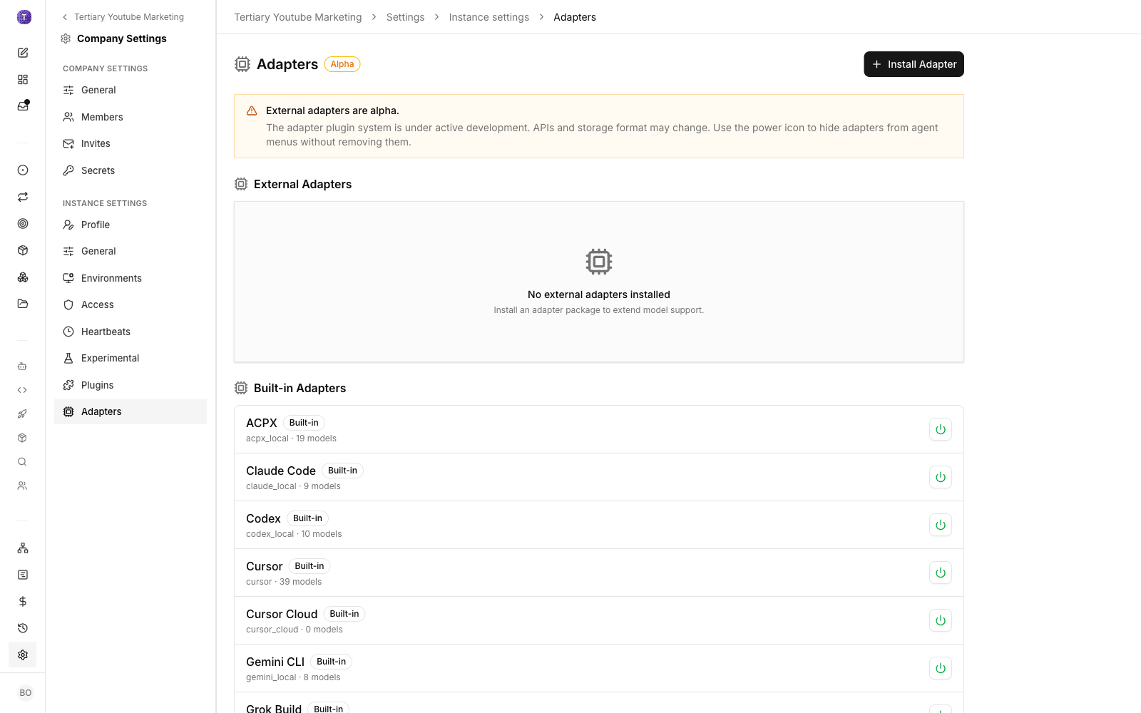
TOPIC 3 · LAB 6
Adapters — the Agents' Engine
▸ Enable the runtime you already have — Claude Code, Codex, Gemini CLI or Hermes — and test the connection.
© Tertiary Infotech Academy Pte Ltd
Human-AI Workforce with Autonomous AI Agents · TGS-2024043854
114

Slide 115
TOPIC 3 · LAB 6
Give Ava her mandate
PROMPT · copy from the Lab Prompts page
Paste into
You are Ava, CEO of Kopi Kaki Growth Studio, a small AI marketing studio serving Kopi Kaki Co. (a Singapore kopi chain).
Goals: (1) 2,500 app pre-orders for the Gula Melaka Cold Brew by 30 Nov 2026, (2) one approved short video every week, (3) monthly AI spend under USD 60 with zero compliance breaches.
How you work:
- Break goals into projects and tasks; propose hires with a mandate, adapter, reporting line and monthly budget; never hire without Board approval.
- Every public-facing item must pass the Compliance Auditor and then wait for the Board. Never publish anything yourself.
- Before anything is published or any spend outside budget, file a Board approval request.
- Use brand-guide.md, campaign-brief.md and compliance-rules.md as the source of truth.
- Report weekly: goal status, spend vs budget, risks, decisions needed.
Paperclip → Agents → Ava → Instructions → AGENTS.md
Expect
Ava's Instructions show the mandate and the three files.
You decide
You are the Board: goals, budgets, the hiring gate
© Tertiary Infotech Academy Pte Ltd
Human-AI Workforce with Autonomous AI Agents · TGS-2024043854
115

Slide 116
TOPIC 3 · LAB 6
Lab 6 — Checkpoint & Reflection
Verify
http://localhost:3100 loads Kopi Kaki Growth Studio
Verify
Ava's role is CEO and her Run test passes
Verify
'Require board approval for new hires' is ON
Concepts in action
Paperclip = the company; agents = employees; you = the Board · Goal → project → task: every task traces to a company goal
Stretch challenge
Compare your Paperclip company with the Hermes studio from Lab 4: which governance features (org chart, budgets, hiring gate, audit log) would you have had to build yourself in Hermes?
© Tertiary Infotech Academy Pte Ltd
Human-AI Workforce with Autonomous AI Agents · TGS-2024043854
116

Slide 117
TOPIC 3 · LAB 7
Lab 7 — Hire the Marketing Team Through the Board Approval Gate
Let the CEO design the team, then approve, push back on or reshape every hire — with budgets, a Tavily web-search secret, a shared brand skill and an independent auditor.
The business scenario
You will deliver
✓ A plan document from Ava (roles, mandates, adapters, budgets, reporting lines)
✓ 5 specialists hired through Approvals: Market Researcher, Content Strategist, Copywriter, Video Producer, Compliance Auditor
✓ At least one hire sent back with 'Request revision' and resubmitted
✓ Organization secret tavily_api_key bound to the researcher as TAVILY_API_KEY
✓ kopi-brand-voice skill in the company library, attached to the Copywriter and Auditor
Ava needs a team to hit the goals. In a real company you would never let a manager hire without approval, and you would never let the person who writes the ads also approve them. You ask Ava for a hiring plan, approve the hires that make sense, push back on one, give the researcher live web search, share the brand-voice skill, and make sure the Compliance Auditor reports to the CEO — not to the content team it audits.
Agents CEO + 5 specialist agents
Human role Approve, revise or reject each hire; enforce separation of duties
Time 45 min · Multi-agent organisation · labs/lab07-paperclip-hire-marketing-team/
© Tertiary Infotech Academy Pte Ltd
Human-AI Workforce with Autonomous AI Agents · TGS-2024043854
117

Slide 118


TOPIC 3 · LAB 7
Lab 7 — How the workflow runs
Perception → reasoning → action, with you at the checkpoints.
AGENT · STEP 1
HUMAN · STEP 2
AGENT · STEP 3
HUMAN · STEP 4
HUMAN · STEP 5
AGENT · STEP 6
Plan
Approve
Onboard
Secret
Skill
Smoke test
Ava proposes the team in a plan.
Approve, revise or reject each hire.
Specialists come online with budgets.
tavily_api_key → TAVILY_API_KEY.
Share kopi-brand-voice.
Researcher returns cited results.
Checkpoint Five specialists in the Org chart view; the auditor reports to Ava; the researcher's smoke test returns cited Tavily results.
© Tertiary Infotech Academy Pte Ltd
Human-AI Workforce with Autonomous AI Agents · TGS-2024043854
118

Slide 119
TOPIC 3 · LAB 7
A Good Hiring Plan (reference)
Role | Reports to | Mandate | Budget / mo
Market Researcher | CEO | Live trend, competitor and audience research with Tavily; cites sources | USD 8
Content Strategist | CEO | Campaign plan, calendar and briefs | USD 8
Copywriter | Content Strategist | Captions, scripts, replies in brand voice | USD 8
Video Producer | Content Strategist | Storyboards, renders, publish package | USD 10
Compliance Auditor | CEO | Audits every public item (C1–C10, V1–V9); can block release | USD 5
TIP Separation of duties: the auditor must not report to the people whose work it audits.
© Tertiary Infotech Academy Pte Ltd
Human-AI Workforce with Autonomous AI Agents · TGS-2024043854
119

Slide 120
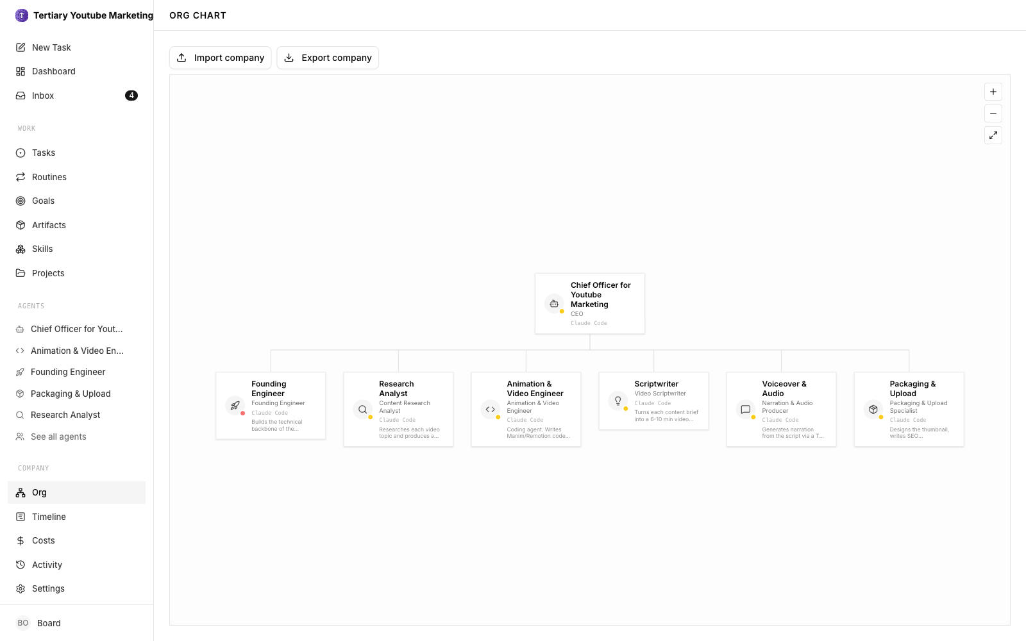
TOPIC 3 · LAB 7
The Org Chart
▸ Board → CEO → specialists. Every hire passed an explicit Board decision.
© Tertiary Infotech Academy Pte Ltd
Human-AI Workforce with Autonomous AI Agents · TGS-2024043854
120

Slide 121
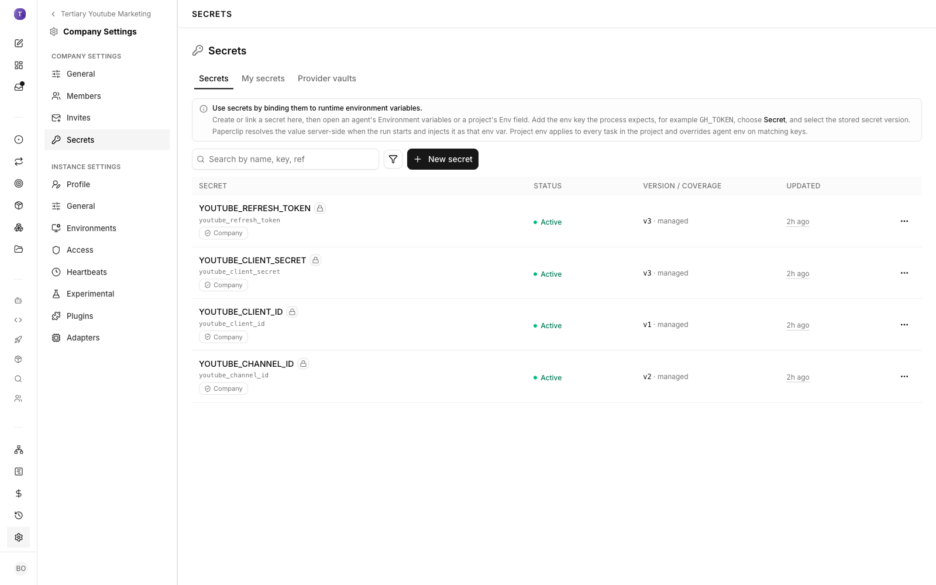
TOPIC 3 · LAB 7
Secrets — Tools Without Exposing Keys
▸ Store TAVILY_API_KEY as a company Secret and bind it to the researcher's runtime — it never appears in prompts or issues.
© Tertiary Infotech Academy Pte Ltd
Human-AI Workforce with Autonomous AI Agents · TGS-2024043854
121

Slide 122
TOPIC 3 · LAB 7
Ask the CEO for a hiring plan
PROMPT · copy from the Lab Prompts page
Paste into
Propose the team to hit our three company goals.
Propose the smallest team that can research, plan, write, produce video and audit our marketing every week. For each role give: name, mandate (3 bullets), reports to, adapter, monthly budget in USD, tools and skills it needs.
Rules: the Compliance Auditor must not report to anyone whose work it audits; the total team budget must fit our USD 60/month company budget with Ava's USD 15 included.
Save it as a plan, ask me to confirm, then submit each hire for Board approval with its budget.
Paperclip → New Task (assign to Ava)
Expect
A plan document and a confirmation card; after you confirm, hire requests appear in Approvals.
You decide
Approve, revise or reject each hire; enforce separation of duties
© Tertiary Infotech Academy Pte Ltd
Human-AI Workforce with Autonomous AI Agents · TGS-2024043854
122

Slide 123
TOPIC 3 · LAB 7
Smoke-test the researcher
PROMPT · copy from the Lab Prompts page
Paste into
Smoke test - live search.
Use Tavily to find 3 news items from the last 60 days about coffee or cold-brew trends in Singapore or Southeast Asia. For each: headline, date, URL and a one-line takeaway for Kopi Kaki. Mark anything you could not verify.
Paperclip → New Task (assign to Market Researcher)
Expect
Three results with URLs in the task thread.
You decide
Approve, revise or reject each hire; enforce separation of duties
© Tertiary Infotech Academy Pte Ltd
Human-AI Workforce with Autonomous AI Agents · TGS-2024043854
123

Slide 124
TOPIC 3 · LAB 7
Lab 7 — Checkpoint & Reflection
Verify
5 specialists active, each with a budget
Verify
At least one hire went through Request revision
Verify
TAVILY_API_KEY bound to the researcher from an organization secret
Concepts in action
Role specialisation + reporting lines = coordination · Separation of duties: the auditor must not report to those it audits
Stretch challenge
Ask Ava to propose a sixth role — Community Manager — and decide whether the value justifies the extra budget. Record your Board decision as an approval comment.
© Tertiary Infotech Academy Pte Ltd
Human-AI Workforce with Autonomous AI Agents · TGS-2024043854
124

Slide 125
TOPIC 3 · LAB 8
Lab 8 — Run the #ShiokColdBrew Launch as a Project — Review, Revise, Release
Turn the campaign into seven linked tasks, let the team execute research → plan → copy → video → audit, and use an approval gate to send work back until it is good enough to release.
The business scenario
You will deliver
✓ Project 'ShiokColdBrew Launch' linked to goal 1, with 7 tasks and blocked-by links
✓ research-report, campaign plan + calendar, teaser captions, video script, video/storyboard + publish package
✓ Compliance audit (agent reviewer) before your approval on captions, video and release pack
✓ At least one task sent back with a comment and returned improved
✓ A retrospective with cycle time, revisions and spend
Ava's team is hired. Now it must deliver the launch campaign pack the Marketing Lead asked for on Day 1 — but as a company: tracked tasks, dependencies, owners, costs and an audit trail. Your job is the Board review: the deliverables that go public stop with you, and you either approve them or send them back with specific comments.
Agents CEO + 5 specialists
Human role Approve or send back every public deliverable; release
Time 55 min · Multi-agent project with Board review · labs/lab08-paperclip-launch-campaign-project/
© Tertiary Infotech Academy Pte Ltd
Human-AI Workforce with Autonomous AI Agents · TGS-2024043854
125

Slide 126
TOPIC 3 · LAB 8
Lab 8 — How the workflow runs
Perception → reasoning → action, with you at the checkpoints.
AGENT · STEP 1
AGENT · STEP 2
AGENT · STEP 3
AGENT · STEP 4
AGENT · STEP 5
HUMAN · STEP 6
Backlog
Research
Plan & write
Produce
Audit
Board review
Project + 7 linked tasks.
Cited trends and angles.
Plan, calendar, captions, script.
Video or storyboard + package.
Auditor reviews C1–C10 / V1–V9.
Approve or send back; release.
Checkpoint All 7 tasks done; at least one went back from in_review with a comment and returned improved; the release pack was approved by you with a comment.
© Tertiary Infotech Academy Pte Ltd
Human-AI Workforce with Autonomous AI Agents · TGS-2024043854
126

Slide 127
TOPIC 3 · LAB 8
The Launch Backlog (paperclip-backlog.csv)
# | Issue | Owner | Blocked by
1 | Research SG cold-brew trends & competitor moves | Market Researcher | —
2 | Campaign plan + 4-week content calendar | Content Strategist | 1
3 | Teaser-week captions (7 posts) | Copywriter | 2
4 | Script & storyboard the 25-s launch video | Video Producer | 2
5 | Render video + publish package | Video Producer | 4
6 | Compliance audit of captions and video | Compliance Auditor | 3, 5
7 | Board review & release pack | CEO | 6
© Tertiary Infotech Academy Pte Ltd
Human-AI Workforce with Autonomous AI Agents · TGS-2024043854
127

Slide 128
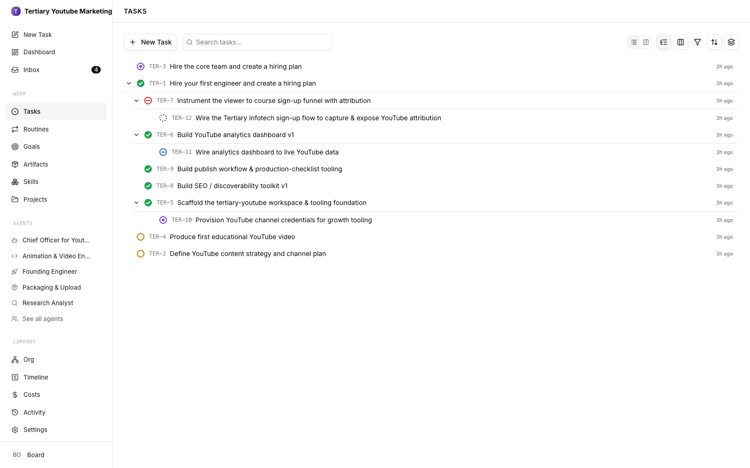
TOPIC 3 · LAB 8
Issues Flow to the Board
▸ todo → in_progress → in_review → done. in_review is your quality gate: approve, or request changes with specific comments.
© Tertiary Infotech Academy Pte Ltd
Human-AI Workforce with Autonomous AI Agents · TGS-2024043854
128

Slide 129
TOPIC 3 · LAB 8
Let the CEO build the backlog
PROMPT · copy from the Lab Prompts page
Paste into
Set up the ShiokColdBrew Launch backlog.
Create the 7 tasks in paperclip-backlog.csv inside project "ShiokColdBrew Launch" - same titles, assignees, priorities, blocked-by links and definitions of done (paste the definition of done into each task). Tasks 1 and 2 must start from the Day 1 research brief and content calendar attached to the project. Reply with the task keys.
Paperclip → New Task (assign to Ava, project ShiokColdBrew Launch)
Expect
7 tasks with owners and blocked-by relationships.
You decide
Approve or send back every public deliverable; release
© Tertiary Infotech Academy Pte Ltd
Human-AI Workforce with Autonomous AI Agents · TGS-2024043854
129

Slide 130
TOPIC 3 · LAB 8
Run the retrospective
PROMPT · copy from the Lab Prompts page
Paste into
Launch project retrospective for ShiokColdBrew Launch.
Report: cycle time per task, number of Board send-backs and auditor findings, spend per agent vs budget, and the three biggest quality problems we caught at review. Recommend two changes to agent instructions that would have prevented them.
Paperclip → New Task (assign to Ava)
Expect
A retrospective with metrics and two instruction changes (you will apply them in Lab 10).
You decide
Approve or send back every public deliverable; release
© Tertiary Infotech Academy Pte Ltd
Human-AI Workforce with Autonomous AI Agents · TGS-2024043854
130

Slide 131
TOPIC 3 · LAB 8
Lab 8 — Checkpoint & Reflection
Verify
Project linked to goal 1 with 7 linked tasks, all done
Verify
Reviewer = Compliance Auditor and Approver = you on tasks 3, 5, 7
Verify
≥ 1 send-back with comment visible in Audit → Activity
Concepts in action
Tasks + blocked-by = an ordered workflow with owners · Execution policy: agent Reviewer, then human Approver
Stretch challenge
Add a dependency the plan missed (e.g. 'Legal check of SHIOK20 terms' before release). How does one new gate change cycle time and risk?
© Tertiary Infotech Academy Pte Ltd
Human-AI Workforce with Autonomous AI Agents · TGS-2024043854
131

Slide 132
TOPIC 3 · LAB 9
Lab 9 — Automate the Weekly Video Pipeline with a Routine and a Board Gate
Turn research → script → production → audit → publish-ready into a routine that fires every Monday at 10:00 — and still stops for your approval.
The business scenario
You will deliver
✓ Routine 'Weekly Kopi Short' for Ava — schedule trigger every week, Monday 10:00, Asia/Singapore
✓ One manual Run that produced a complete package
✓ Publish package + video/storyboard + audit in the run's task
✓ A Board Approval request that you approved (or rejected) with a comment
Goal 2 is one approved short video every week. You do not want to create the task by hand every Monday, but you also never want a video to go out unseen. You create the 'Weekly Kopi Short' routine: the clock creates the task, Ava delegates the pipeline, and the finished package waits for a Board approval.
Agents CEO + Researcher + Copywriter + Video Producer + Auditor
Human role Approve each week's video before it is published
Time 45 min · Scheduled multi-agent workflow · labs/lab09-paperclip-weekly-video-routine/
© Tertiary Infotech Academy Pte Ltd
Human-AI Workforce with Autonomous AI Agents · TGS-2024043854
132

Slide 133
TOPIC 3 · LAB 9
Lab 9 — How the workflow runs
Perception → reasoning → action, with you at the checkpoints.
AGENT · STEP 1
AGENT · STEP 2
AGENT · STEP 3
AGENT · STEP 4
AGENT · STEP 5
HUMAN · STEP 6
Trigger
Research
Script
Produce
Audit
Approve
Monday 10:00 creates the task.
Fresh angle, 2 sources.
20–30 s in brand voice.
Video or 6-frame storyboard.
PASS / FAIL with fixes.
Board Approval before publishing.
Checkpoint A manual Run produced a full package and a Board Approval request; the routine shows a weekly Monday 10:00 Asia/Singapore trigger.
© Tertiary Infotech Academy Pte Ltd
Human-AI Workforce with Autonomous AI Agents · TGS-2024043854
133

Slide 134
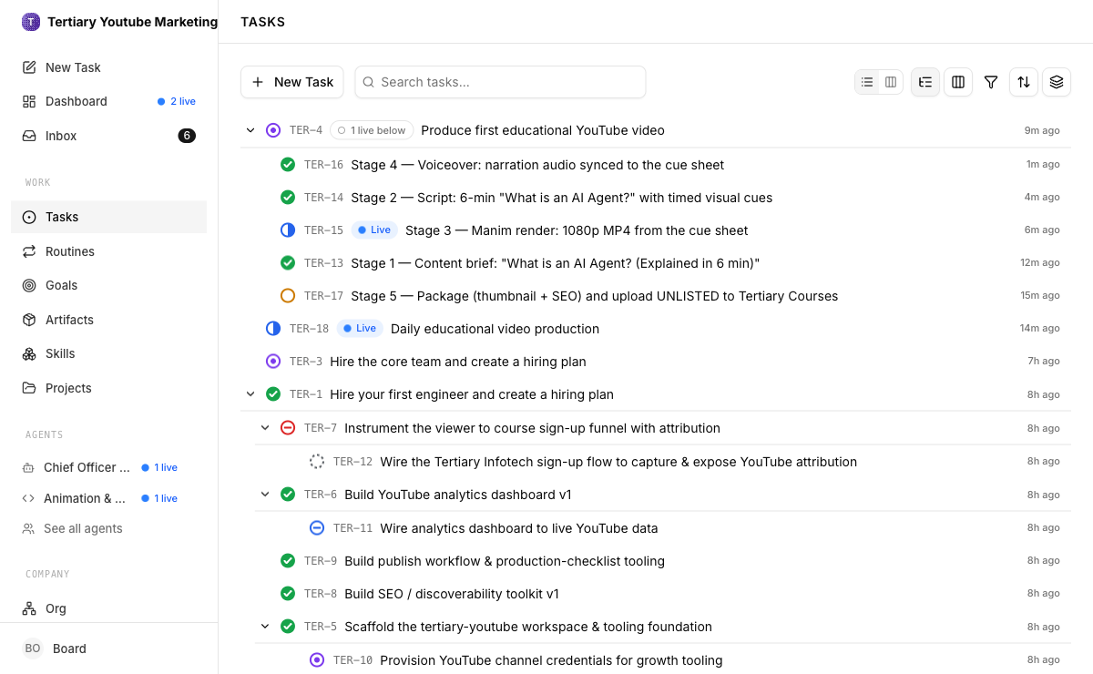
TOPIC 3 · LAB 9
A Routine Fires the Pipeline
▸ Work → Routines: a schedule trigger (Monday 10:00, Asia/Singapore) generates the issue; the CEO delegates each stage.
© Tertiary Infotech Academy Pte Ltd
Human-AI Workforce with Autonomous AI Agents · TGS-2024043854
134

Slide 135
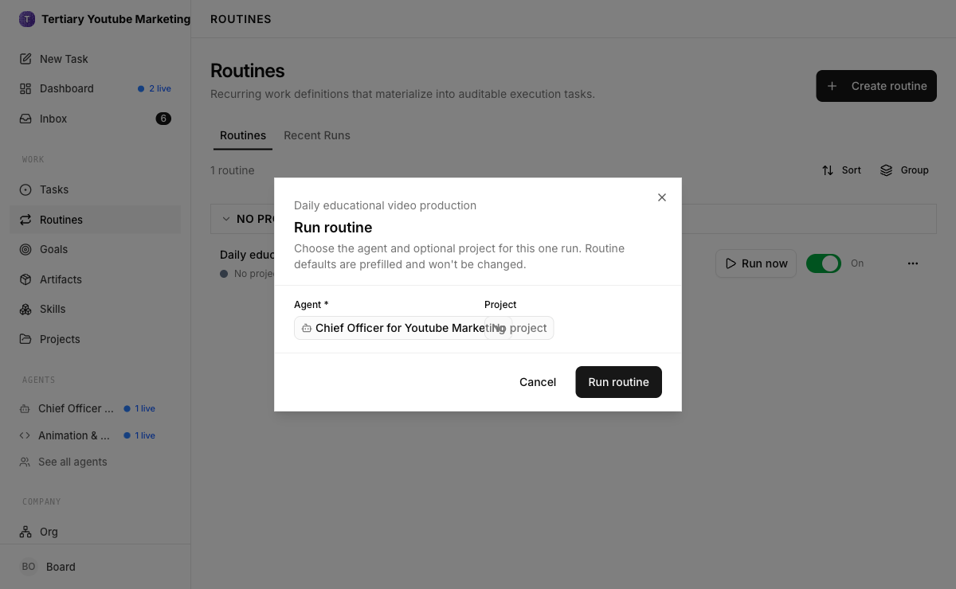
TOPIC 3 · LAB 9
Run Now — Test Before You Trust
▸ Trigger the routine manually once and follow every stage before relying on the schedule.
© Tertiary Infotech Academy Pte Ltd
Human-AI Workforce with Autonomous AI Agents · TGS-2024043854
135

Slide 136
TOPIC 3 · LAB 9
Create the routine
PROMPT · copy from the Lab Prompts page
Paste into
Produce this week's Kopi Short (research -> script -> production -> audit -> publish-ready).
Delegate: Market Researcher picks one fresh angle (cite 2 sources); Copywriter writes a 20-30 second script in the Kopi Kaki voice (kopi-brand-voice); Video Producer renders the video, or a 6-frame storyboard if rendering is unavailable; Compliance Auditor checks compliance-rules.md (C1-C10) and video-qa-checklist.md (V1-V9).
Deliver a publish package: title, description with AI disclosure, 3-5 hashtags incl. #ShiokColdBrew, thumbnail, captions.
Gate: before anything is published, file a Board approval request with the package attached. Do NOT publish. Stay within each agent's budget.
Paperclip → Routines → Create routine → Instructions
Expect
The routine lands on its Triggers tab.
You decide
Approve each week's video before it is published
© Tertiary Infotech Academy Pte Ltd
Human-AI Workforce with Autonomous AI Agents · TGS-2024043854
136

Slide 137
TOPIC 3 · LAB 9
Lab 9 — Checkpoint & Reflection
Verify
Routine active with a weekly Monday 10:00 Asia/Singapore trigger
Verify
Manual run created a task and completed the pipeline
Verify
The generated task shows you as Approver
Concepts in action
Routine = trigger + generated task (a cron for a company) · Heartbeats: agents wake on schedule or on assignment
Stretch challenge
Add a second trigger: a webhook that starts the pipeline when a competitor launches a product. What new risks does an event-driven trigger add, and what gate would you add?
© Tertiary Infotech Academy Pte Ltd
Human-AI Workforce with Autonomous AI Agents · TGS-2024043854
137

Slide 138
TOPIC 3 · LAB 10
Lab 10 — Govern, Measure & Improve Your Human–AI Workforce
Read the costs and the audit trail, score every agent, pause or re-budget one, fix the instructions that caused rework, and present a Board report on what the AI workforce delivered.
The business scenario
You will deliver
✓ scorecard — per-agent output, quality, cost vs budget with a RAG status
✓ One agent paused or re-budgeted, with the reason in a comment
✓ Improved instructions for the agent with the most revisions and audit findings — the Copywriter in the mock data (a new Revision you can restore)
✓ board-report — value, cost, risk, human role, next-quarter decisions — approved by you
One month in, the owners ask the Board three questions: what did the AI workforce deliver, what did it cost, and is it safe? You use Paperclip's dashboard, Audit (Activity, Runs, Costs, Budgets) and your scorecard to answer — and you act: pause or re-budget the agent in the red, improve the instructions that caused rework, and decide what humans keep doing.
Agents Whole company (CEO + 5 specialists)
Human role Evaluate, intervene, improve, report — and stay accountable
Time 45 min · Workforce governance · labs/lab10-paperclip-govern-measure-improve/
© Tertiary Infotech Academy Pte Ltd
Human-AI Workforce with Autonomous AI Agents · TGS-2024043854
138

Slide 139



TOPIC 3 · LAB 10
Lab 10 — How the workflow runs
Perception → reasoning → action, with you at the checkpoints.
AGENT · STEP 1
AGENT · STEP 2
AGENT · STEP 3
HUMAN · STEP 4
HUMAN · STEP 5
HUMAN · STEP 6
Costs
Audit trail
Scorecard
Intervene
Improve
Report
Spend by agent vs budget.
Approvals, send-backs, budget events.
Output, quality, cost per agent.
Pause / re-budget one agent.
Rewrite instructions that caused rework.
Board report: value, cost, risk.
Checkpoint Scorecard numbers match Audit → Costs for at least two agents; one intervention and one instruction change are logged with reasons.
© Tertiary Infotech Academy Pte Ltd
Human-AI Workforce with Autonomous AI Agents · TGS-2024043854
139

Slide 140
TOPIC 3 · LAB 10
Month-1 Agent Scorecard (agent-scorecard.csv)
Agent | Issues done | Audit FAILs | Revisions | Spend / budget (USD) | Status
Ava (CEO) | 13 / 14 | 0 | 1 | 11.20 / 15 | Green
Market Researcher | 9 / 9 | 0 | 0 | 6.10 / 8 | Green
Content Strategist | 6 / 7 | 1 | 1 | 7.90 / 8 | Amber — 99% of budget
Copywriter | 18 / 22 | 4 | 3 | 5.30 / 8 | Amber — quality
Video Producer | 3 / 5 | 2 | 2 | 10.40 / 10 | Red — over budget
Compliance Auditor | 27 / 27 | 0 | 0 | 2.20 / 5 | Green
© Tertiary Infotech Academy Pte Ltd
Human-AI Workforce with Autonomous AI Agents · TGS-2024043854
140

Slide 141
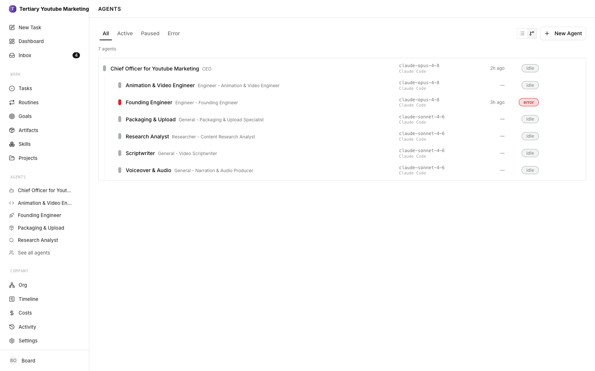
TOPIC 3 · LAB 10
Agents, Budgets and Status
▸ Pause is reversible; terminate is not. Fix the instructions that caused rework — improve the harness.
© Tertiary Infotech Academy Pte Ltd
Human-AI Workforce with Autonomous AI Agents · TGS-2024043854
141

Slide 142
TOPIC 3 · LAB 10
Build the scorecard with the CEO
PROMPT · copy from the Lab Prompts page
Paste into
Monthly agent scorecard.
Using Paperclip's costs and activity data plus agent-scorecard.csv, produce a scorecard with one row per agent: tasks done, Board send-backs, audit findings, spend vs budget, cost per completed task, and a RAG status (green/amber/red) with a one-line reason. Show your calculations.
Paperclip → New Task (assign to Ava; Approvers → Assign to me)
Expect
A scorecard you can spot-check against Audit → Costs.
You decide
Evaluate, intervene, improve, report — and stay accountable
© Tertiary Infotech Academy Pte Ltd
Human-AI Workforce with Autonomous AI Agents · TGS-2024043854
142

Slide 143
TOPIC 3 · LAB 10
Improve the harness, not the blame
PROMPT · copy from the Lab Prompts page
Paste into
Add to your rules:
- Before submitting any caption, run the kopi-brand-voice self-check and fix every FAIL; attach the table to the task.
- Never write health or halal claims (C1, C4). Any post with SHIOK20 must show its exact terms (C3).
- If the same rule fails twice on one task, stop and ask the Content Strategist instead of resubmitting.
Paperclip → Agents → Copywriter → Instructions (AGENTS.md)
Expect
Saved as a new Revision (Governance → Revisions → Restore is your undo). Resume the Video Producer if you paused it.
You decide
Evaluate, intervene, improve, report — and stay accountable
© Tertiary Infotech Academy Pte Ltd
Human-AI Workforce with Autonomous AI Agents · TGS-2024043854
143

Slide 144
TOPIC 3 · LAB 10
Lab 10 — Checkpoint & Reflection
Verify
Scorecard values match Audit → Costs for ≥ 2 agents
Verify
A pause or budget change with a written reason
Verify
New Revision of the Copywriter's instructions
Concepts in action
Evaluate on utility, quality, cost and safety · Budget controls: 80% warning, 100% auto-pause
Stretch challenge
Decide the autonomy level (L1 Operator → L5 Observer) for each agent next quarter and justify it in one line each.
© Tertiary Infotech Academy Pte Ltd
Human-AI Workforce with Autonomous AI Agents · TGS-2024043854
144

Slide 145
TOPIC 3 · SUMMARY
What You Governed on Day 2
A company
A team
Delivery
Governance
Mission, goals, budget and a CEO you approved.
Specialists with mandates, budgets, secrets and an independent auditor.
A launch project and a weekly routine — all through Board review.
Costs, audit trail, scorecard, interventions and a Board report.
© Tertiary Infotech Academy Pte Ltd
Human-AI Workforce with Autonomous AI Agents · TGS-2024043854
145

Slide 146
WRAP-UP
Course Summary & Next Steps
1
Key takeaways
2
Practice exam
3
Assessment
4
Digital attendance
© Tertiary Infotech Academy Pte Ltd · TGS-2024043854

Slide 147
WRAP-UP
Summary & Q&A
Topic 1
Topic 2
Topic 3
Your workforce
Agents loop through perception, reasoning and action; the harness and the human make them reliable.
Hermes took one AI employee to a supervised multi-agent team with skills, memory, cron and gates.
Paperclip ran the same work as a governed company — Board, budgets, routines, audit.
Decide per task: agent, agent team or human — and where the human approves.
© Tertiary Infotech Academy Pte Ltd
Human-AI Workforce with Autonomous AI Agents · TGS-2024043854
147

Slide 148
WRAP-UP
Continue Building Your Human–AI Workforce
Run 24/7
Move Hermes to a small VPS or Docker host so cron and Telegram keep running.
Codify your SOPs
Turn your team's checklists into SKILL.md skills and agent instructions.
Govern from day one
Budgets, approval gates, audit trail — follow IMDA's agentic AI framework.
Measure
Track cycle time, revisions, cost per deliverable and quality before you scale.
© Tertiary Infotech Academy Pte Ltd
Human-AI Workforce with Autonomous AI Agents · TGS-2024043854
148

Slide 149

TEST YOURSELF
Practice Exam
Sharpen your readiness before the final assessment.
Open the portal
https://exams.tertiaryinfotech.com
Time yourself
Attempt it under exam conditions.
Review
Read every explanation; revisit the matching lab.
© Tertiary Infotech Academy Pte Ltd
Human-AI Workforce with Autonomous AI Agents · TGS-2024043854
149

Slide 150
ASSESSMENT
Final Assessment
Written Assessment (WA)
Practical Performance (PP)
Short-Answer Questions — 1 hour, open book. Six questions on the knowledge from Topics 1–3.
Three tasks — ONE screenshot each from Lab 1 (Hermes agent), Lab 4 (multi-agent studio with its human gate) and Lab 7 (Paperclip org chart), plus written analysis. 1 hour, open book.
TIP Take the Assessment digital attendance and submit your answers on the LMS at https://lms-tms.tertiaryinfotech.com/.
© Tertiary Infotech Academy Pte Ltd
Human-AI Workforce with Autonomous AI Agents · TGS-2024043854
150

Slide 151
ASSESSMENT
Assessment Flow
On assessment day, follow these five steps in order.
STEP 1
STEP 2
STEP 3
STEP 4
STEP 5
TRAQOM
Attendance
Assessment
Submit
Sign the record
Scan the TRAQOM QR code on the LMS and complete the survey.
Take the Assessment digital attendance (SSG QR).
Sit the WA (SAQ), then the PP — open book.
Upload your answers on the LMS.
Sign the Assessment Summary Record.
© Tertiary Infotech Academy Pte Ltd
Human-AI Workforce with Autonomous AI Agents · TGS-2024043854
151

Slide 152
BEFORE YOU GO
Certification, TRAQOM Survey & Digital Attendance
TRAQOM Survey (mandatory)
Digital Attendance
Complete the certification & TRAQOM survey to receive your certificate.
Scan the TRAQOM QR code on the LMS.
Take the AM, PM and Assessment digital attendance — scan the SSG QR code.
Minimum 75% attendance is required for funding.
© Tertiary Infotech Academy Pte Ltd
Human-AI Workforce with Autonomous AI Agents · TGS-2024043854
152

Slide 153
Thank You!
Questions? We're here to help — during and after class.
enquiry@tertiaryinfotech.com | +65 6100 0613 | www.tertiarycourses.com.sg

